Slide 1
Model inference of DeepSeek-OCR
Natthawut Chaisueb
02.12.2568

Slide 2
Model inference of DeepSeek-OCR
Prompt templates:
<image>\nFree OCR.
<image>\n<|grounding|>Convert the document to markdown.
<image>\nParse the figure.
<image>\nDescribe this image in detail.
<image>\nLocate <|ref|>the teacher<|/ref|> in the image.
<image>\nIdentify all objects in the image and output them in\nbounding boxes.
<image>\n<|grounding|>OCR the image.
Tasks:
Image description
OCR
MCCS

Slide 3
Image description
Main prompts:
<image>\nDescribe this image in detail.
<image>\nParse the figure.
Prompt engineering:
<image>\nParse all charts and tables. Extract data as HTML tables.
<image>\nDescribe this image in detail. Parse all chart and table data and output them as HTML tables.

Slide 4
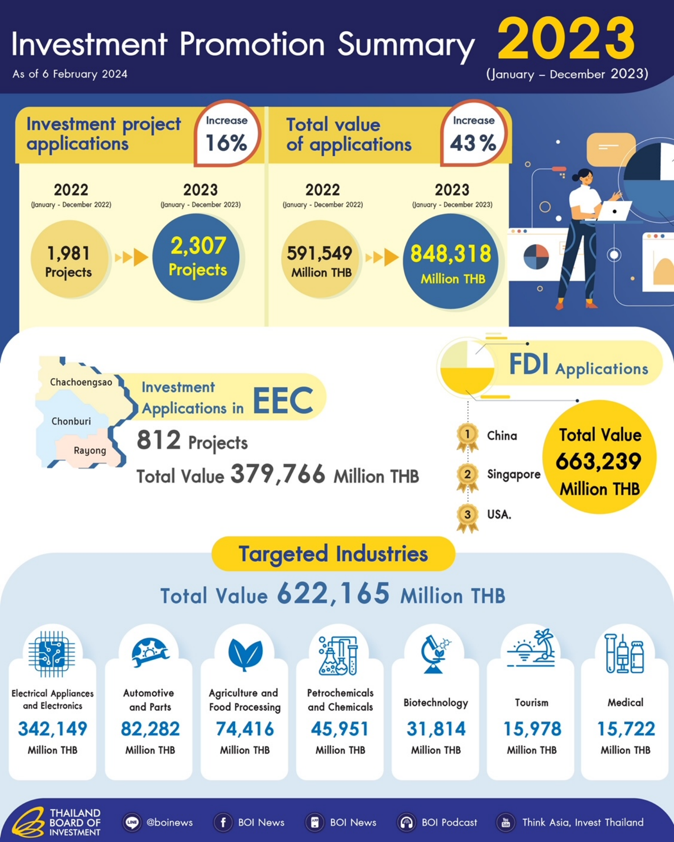
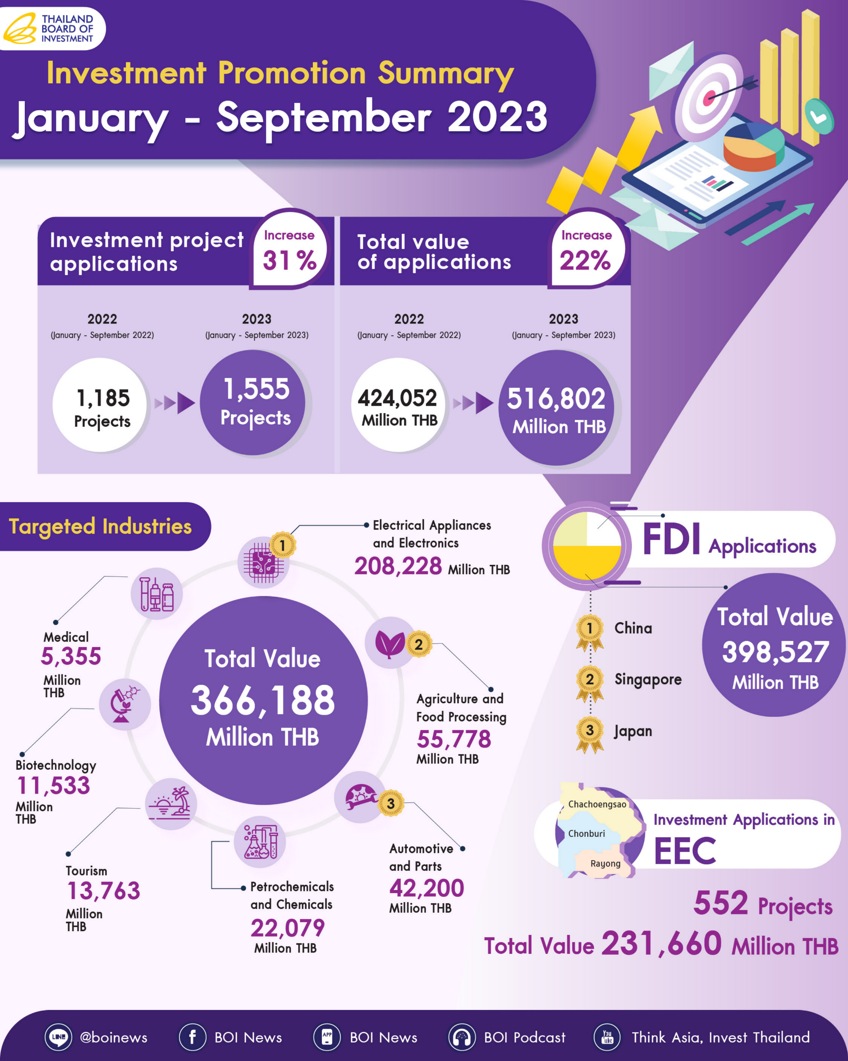
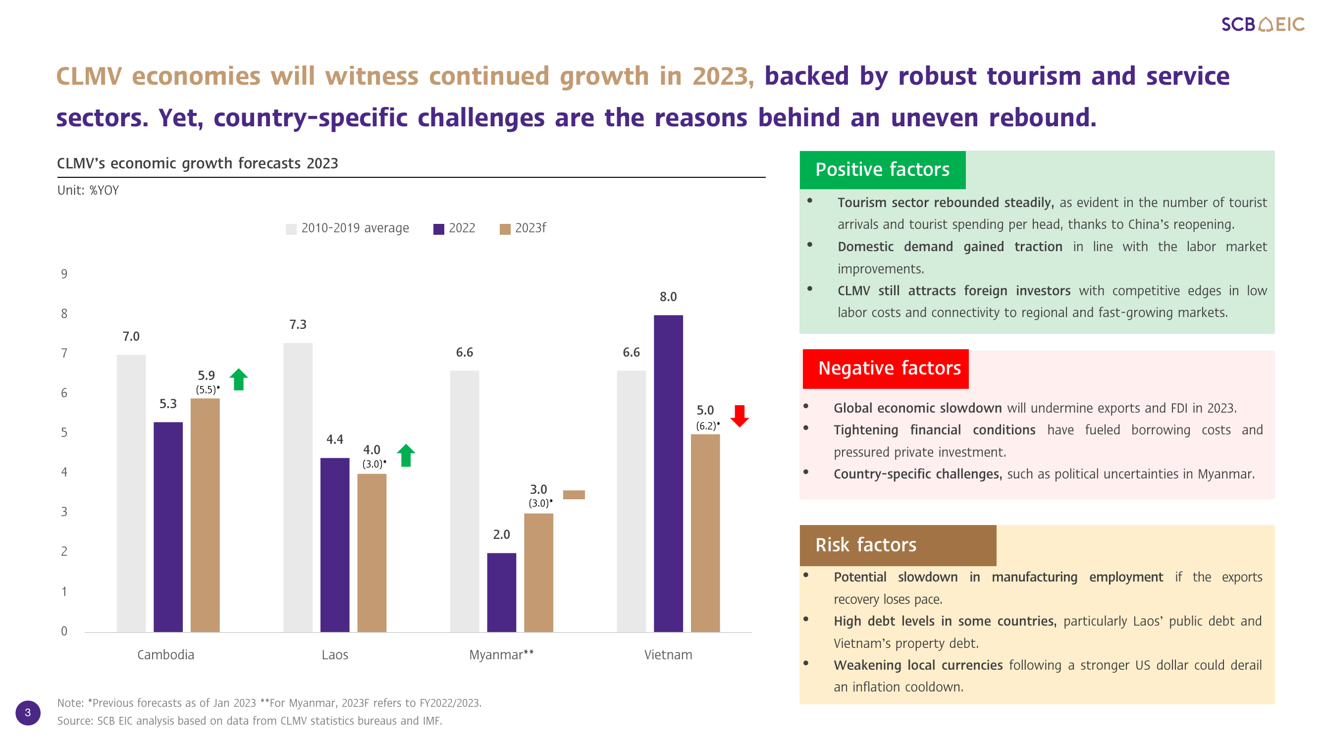
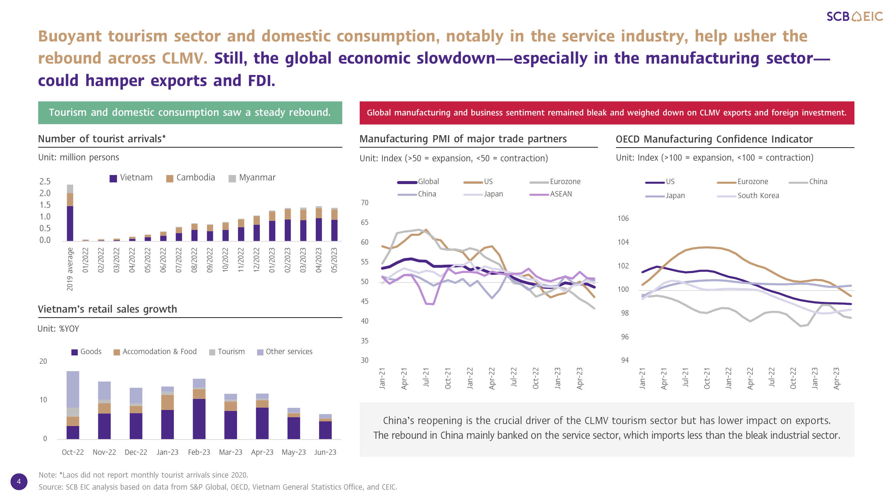

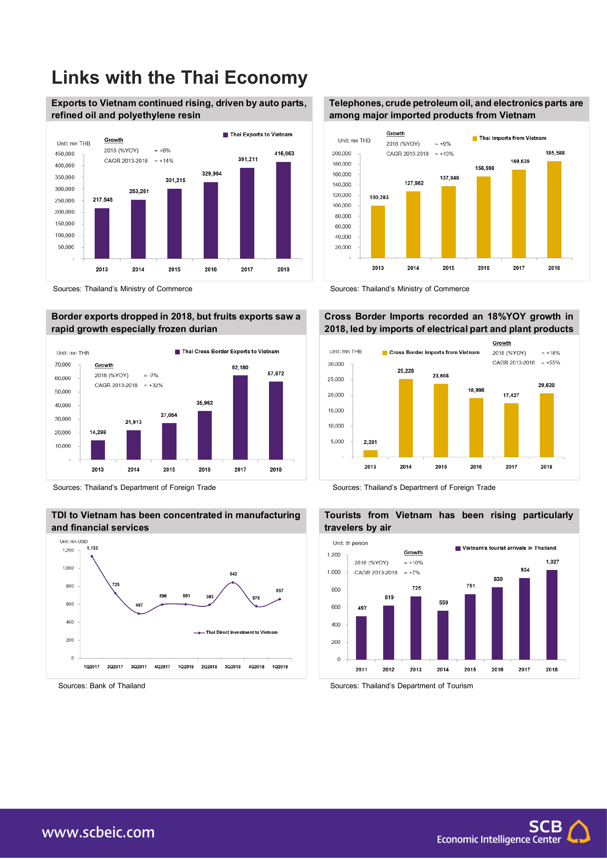
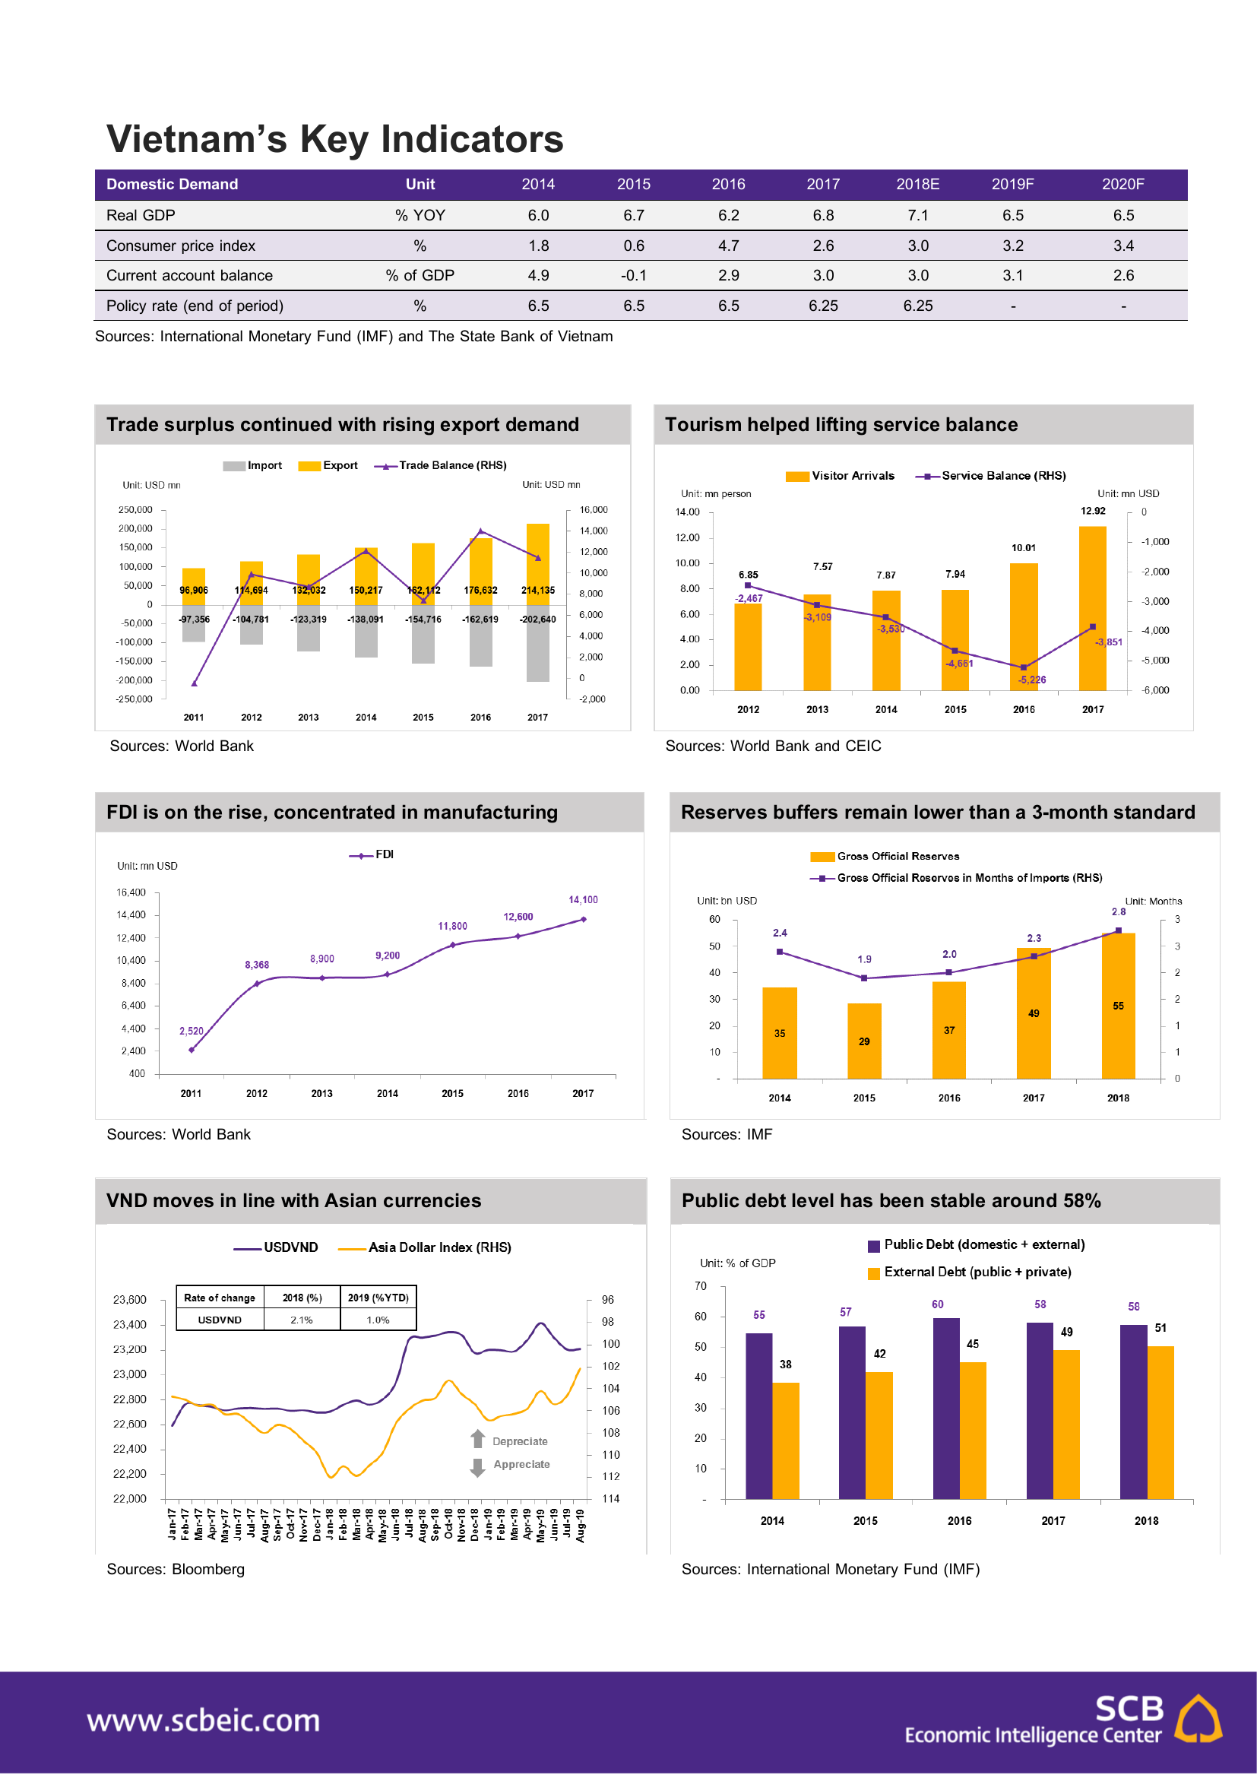
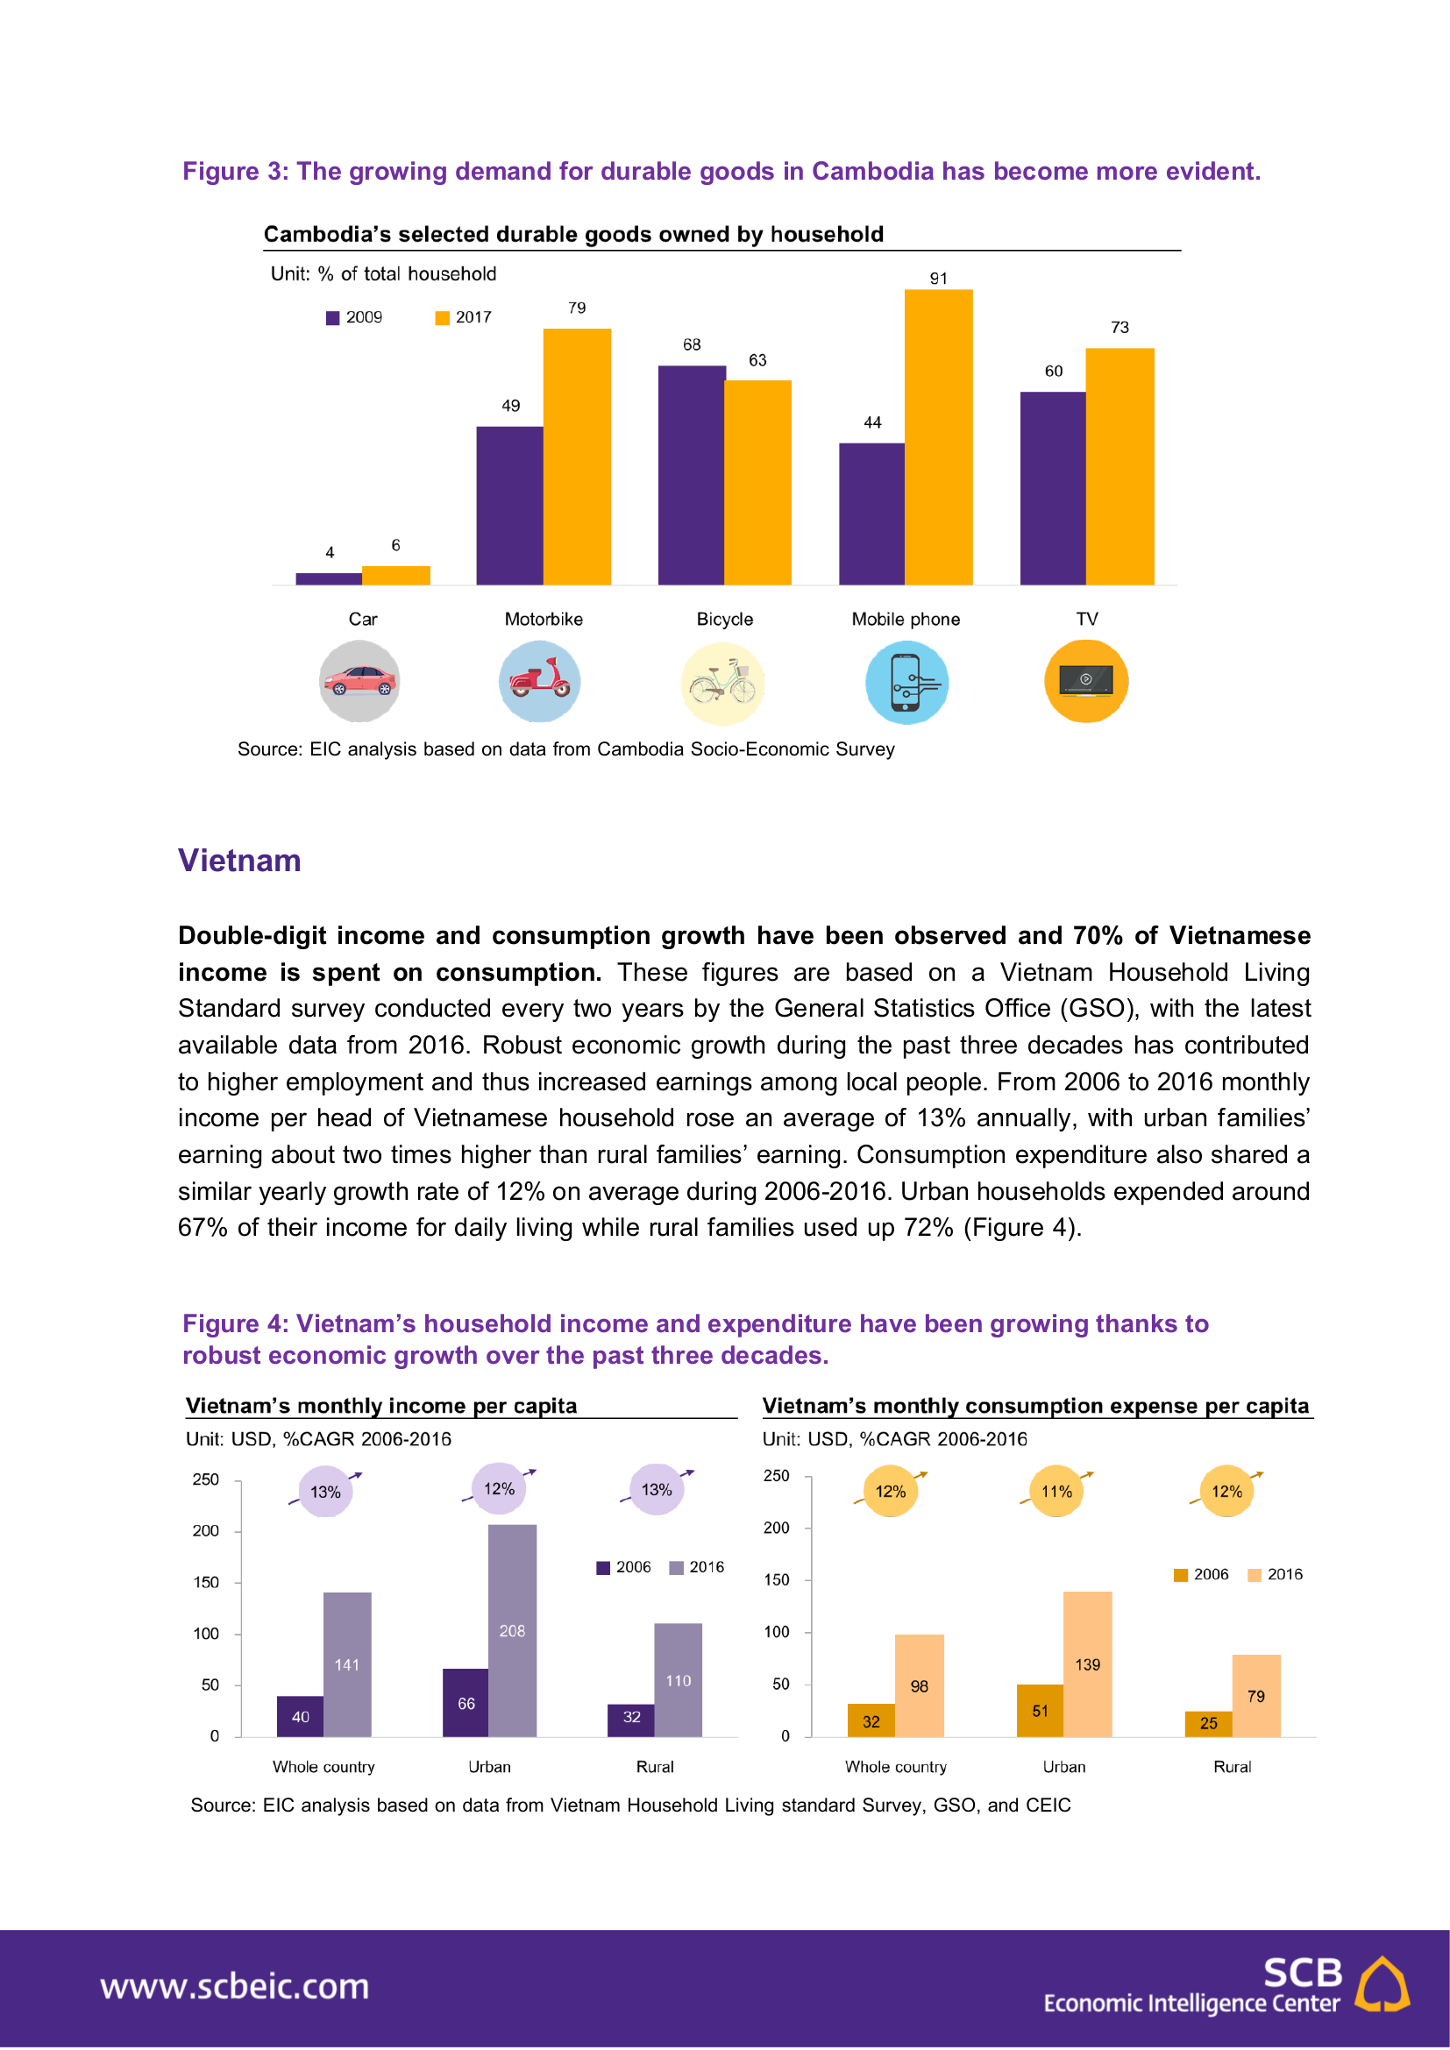
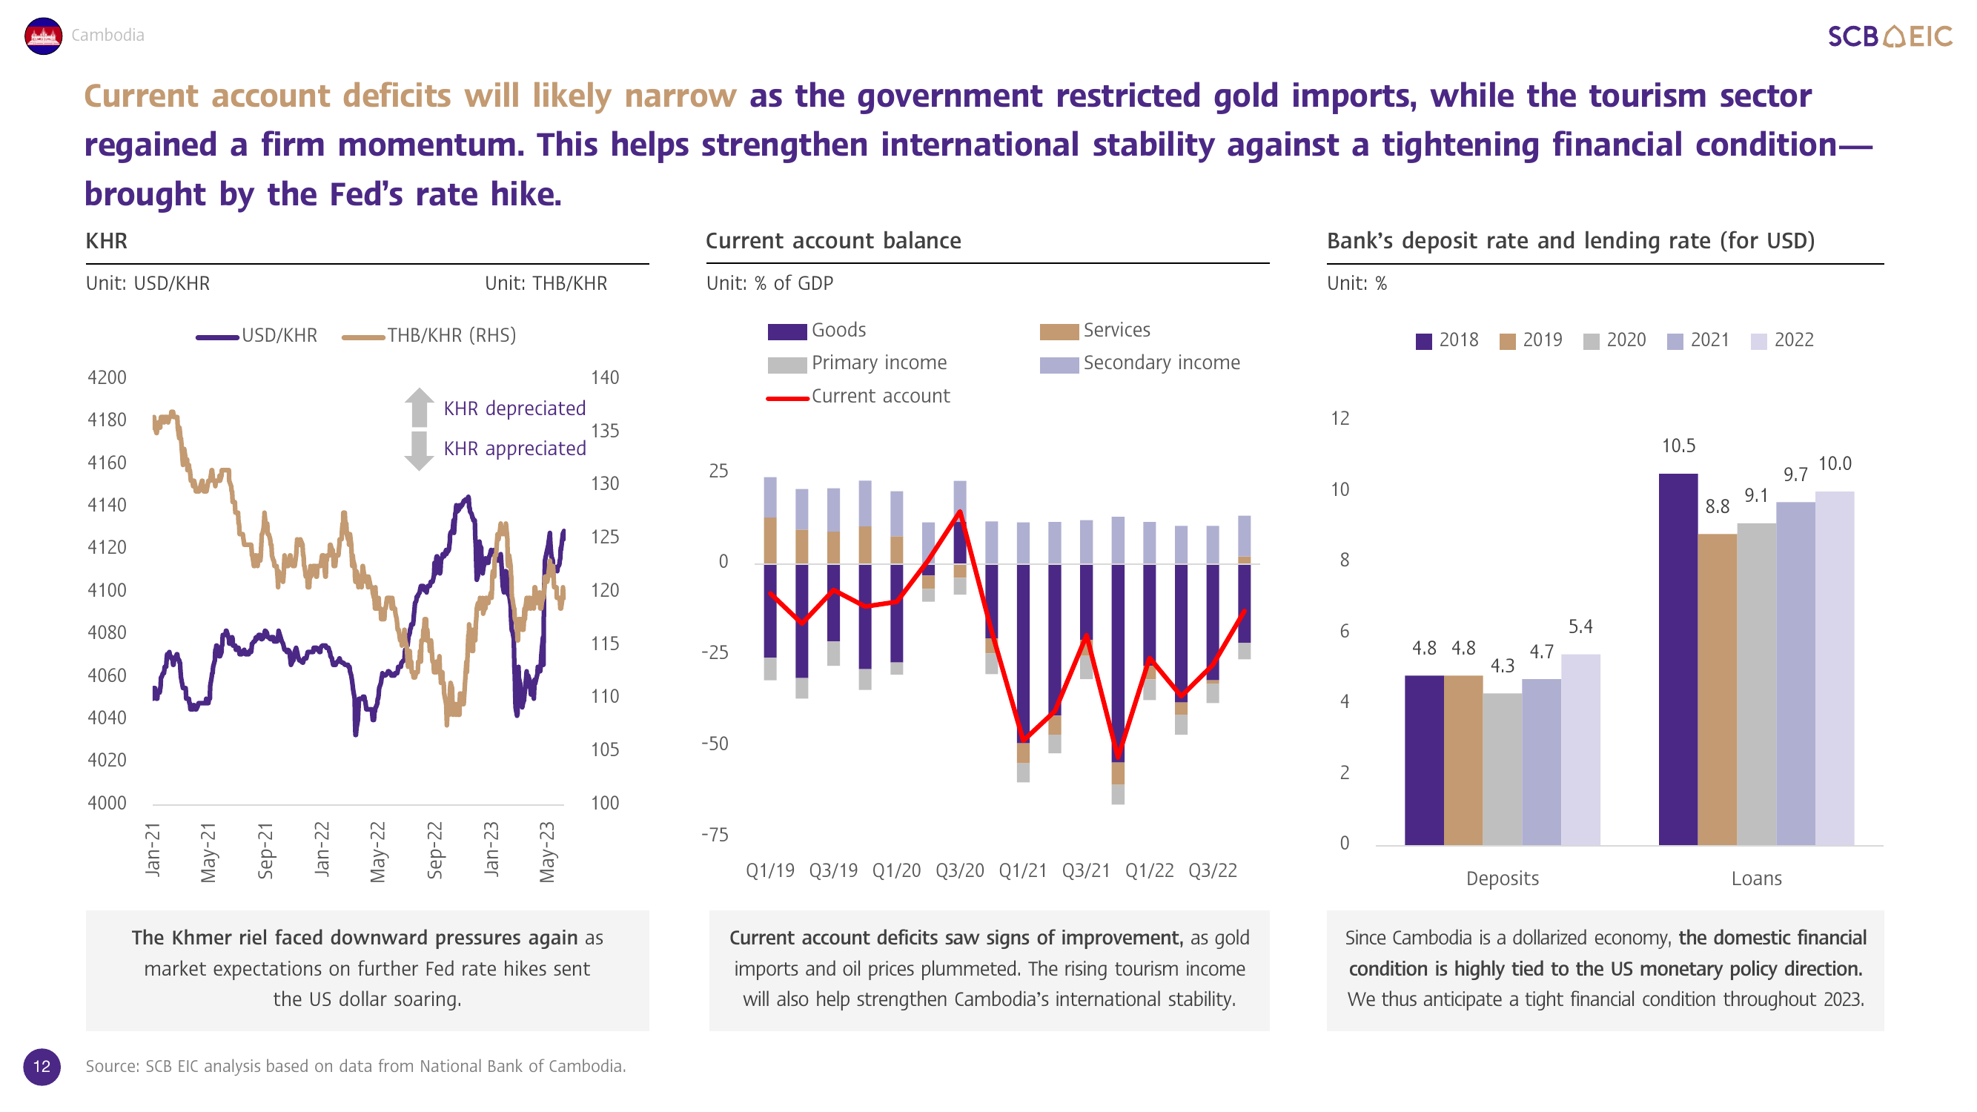
Use case examples in BBL
Documents
Presentation slides
Infographics

Slide 5
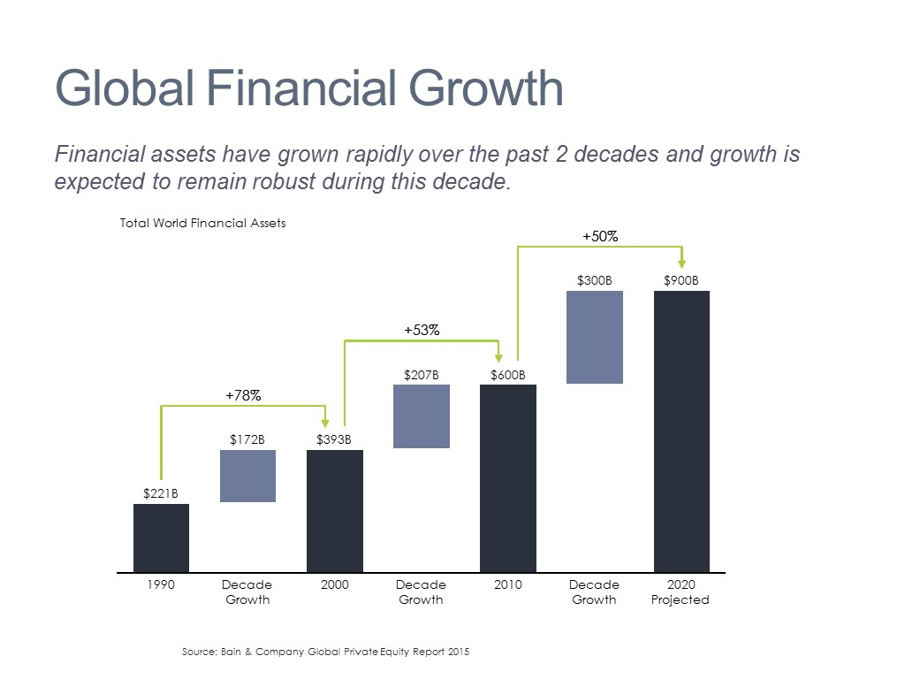
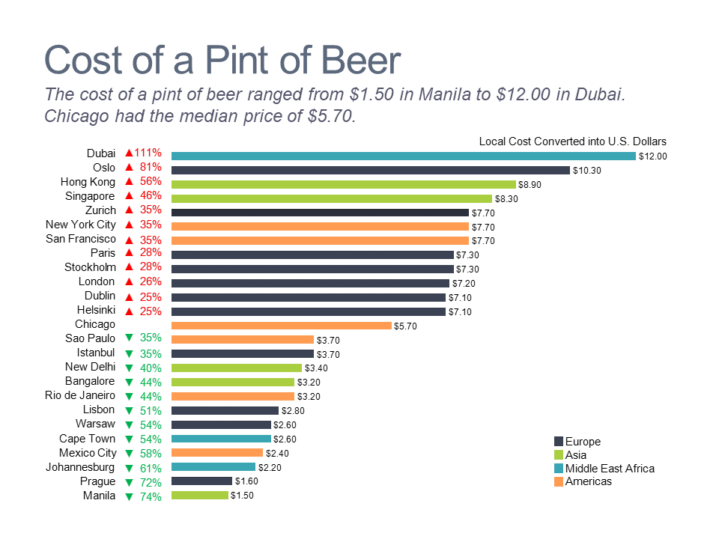
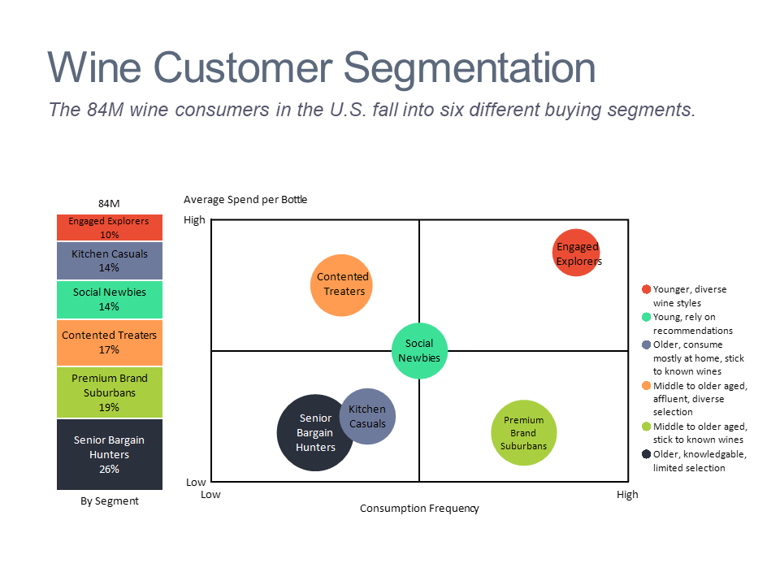
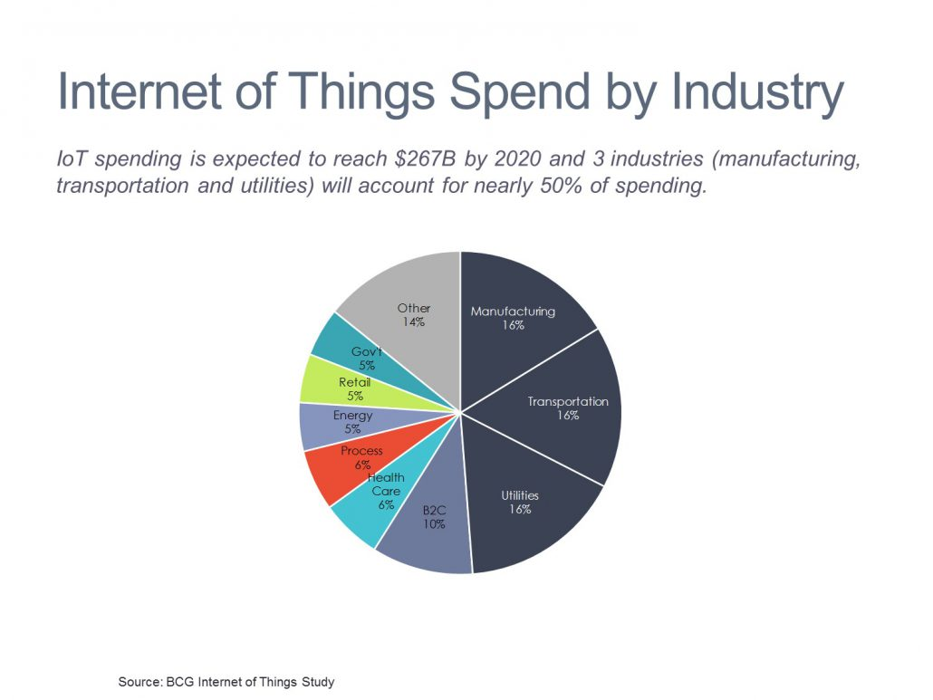
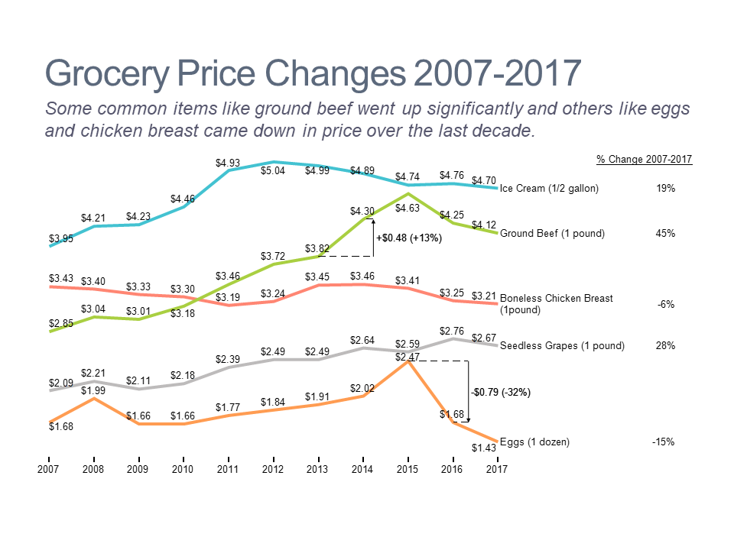
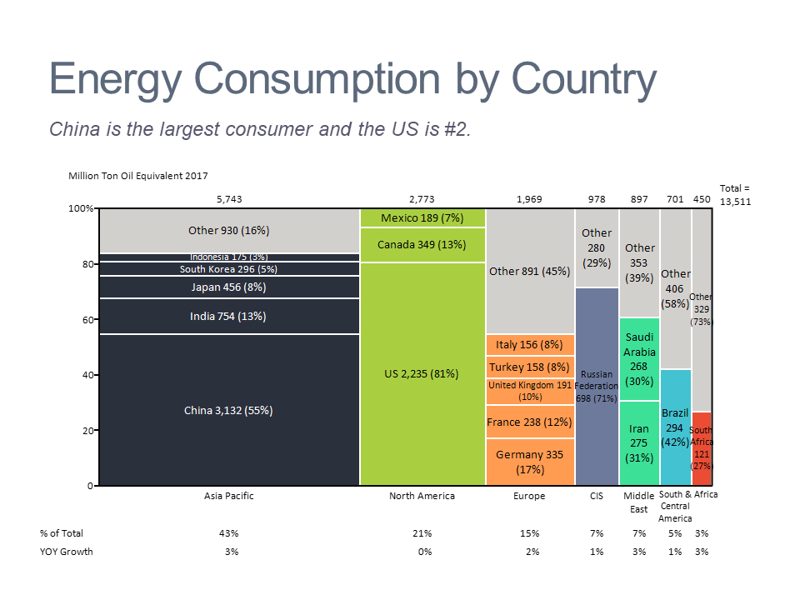
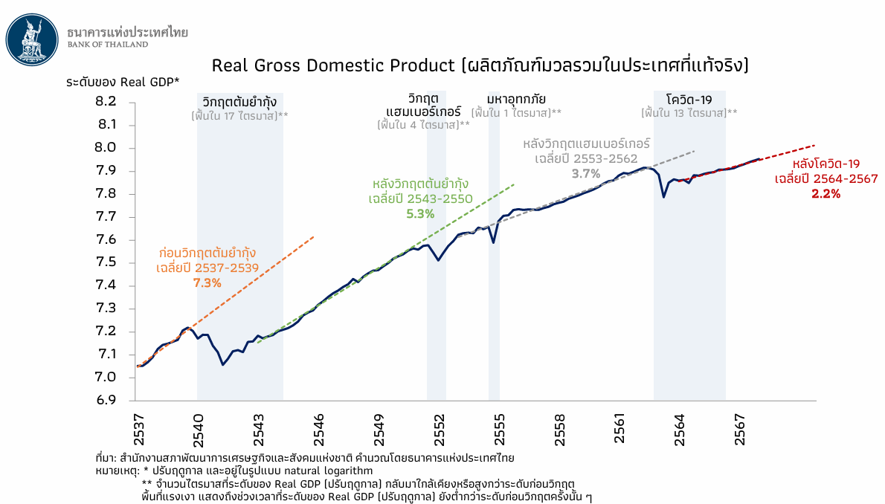
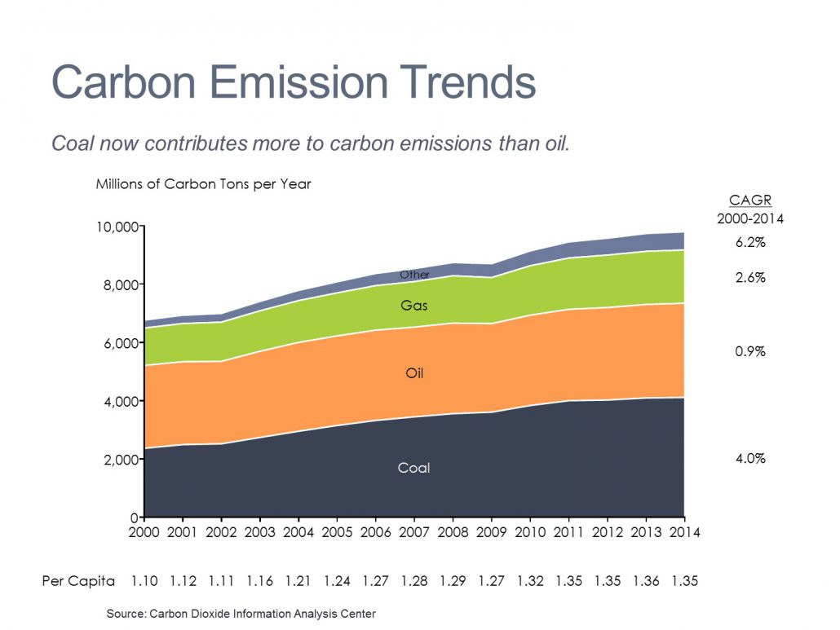
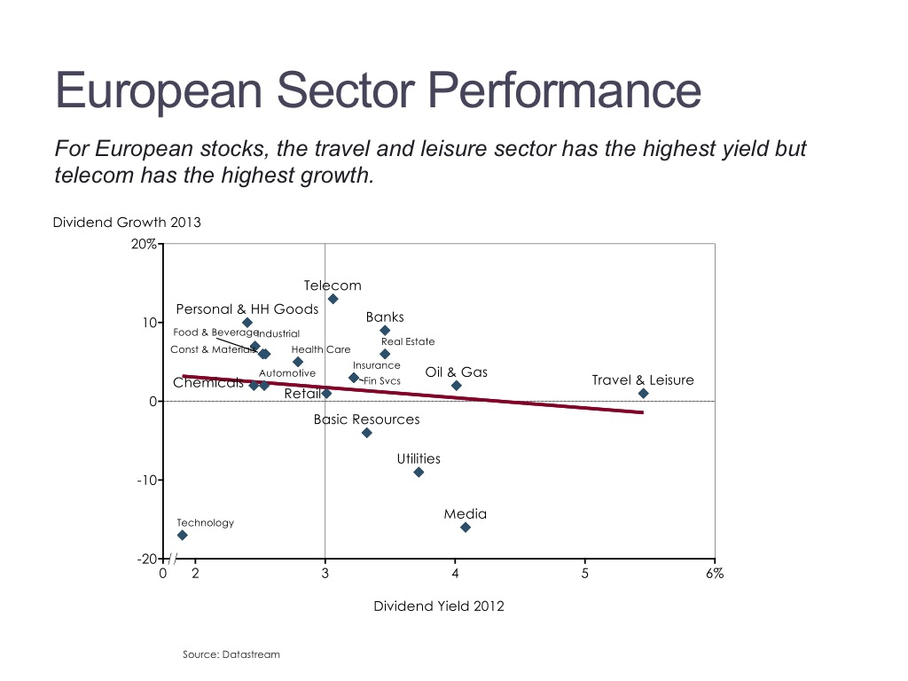
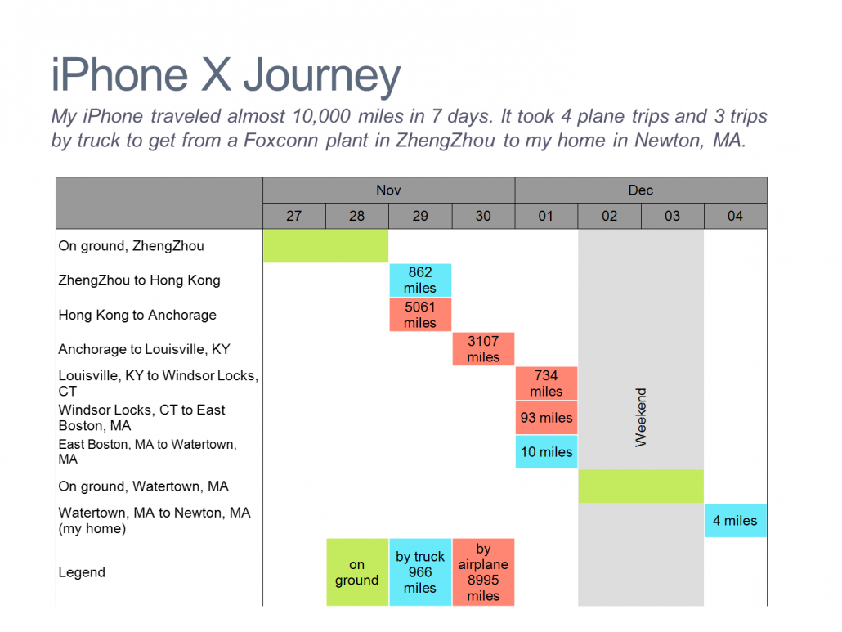
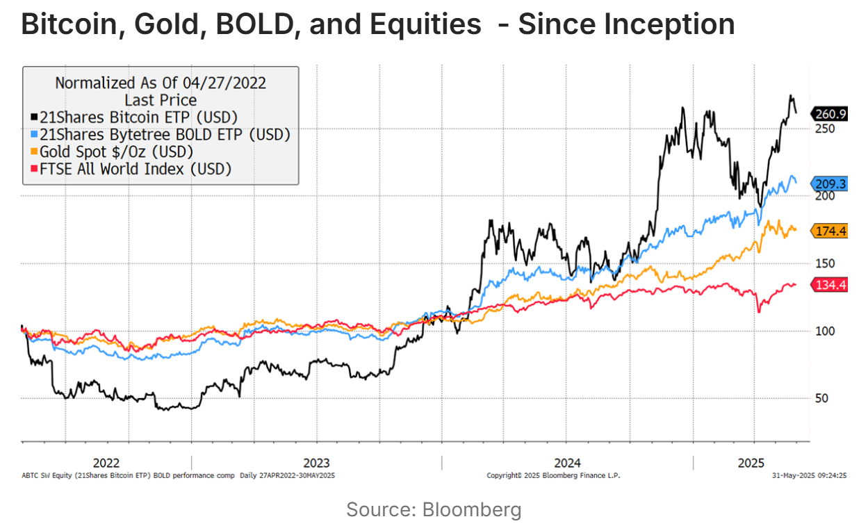
Additional testing data
Line/pie/bar/bubble charts
Scatter/area plots
Trends
Thai plot

Slide 6
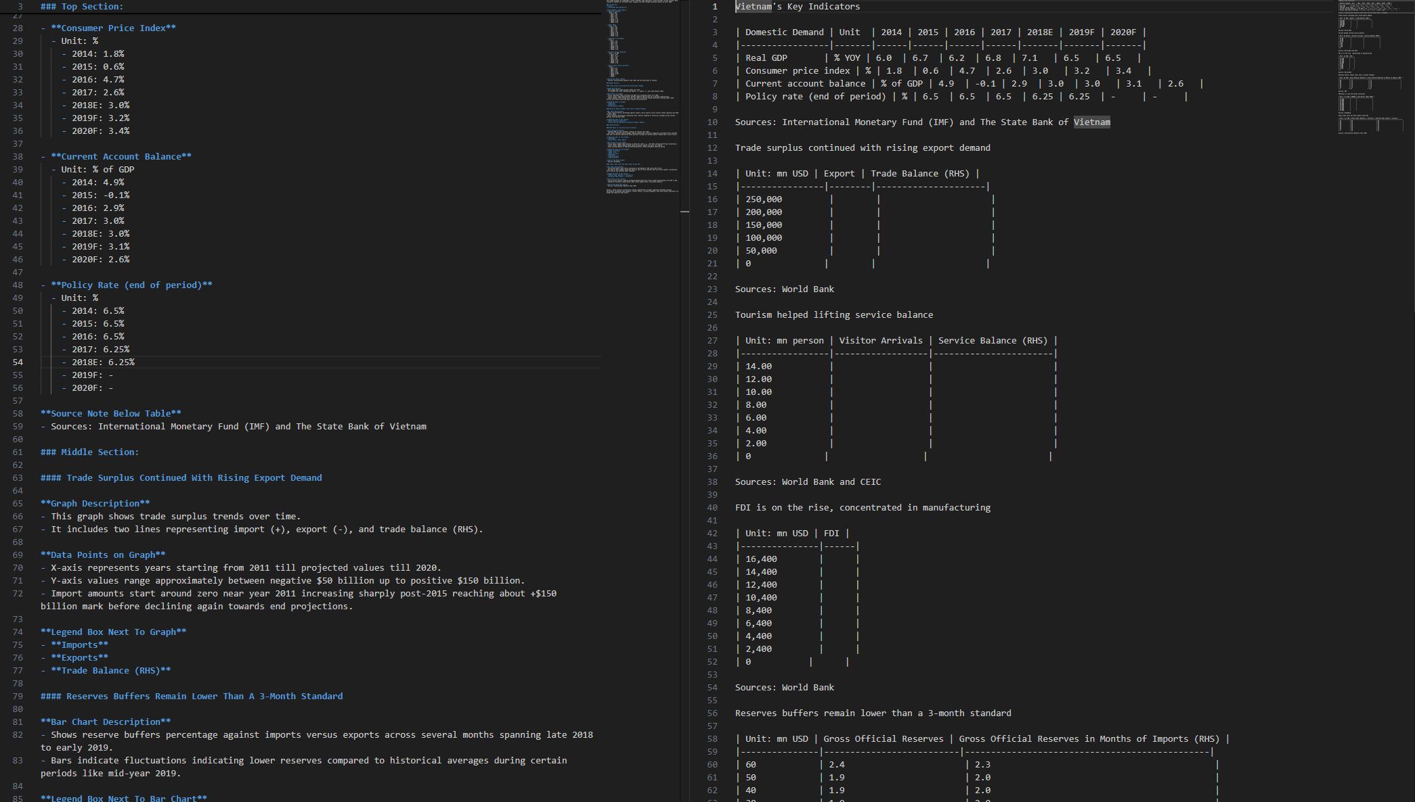
Main prompts
<image>\nDescribe this image in detail.
<image>\nParse the figure.
Top/Middle/Bottom section
Short introduction
Table to bullet points
Graph to description
Graph description
Data points on graph
x-axis, y-axis
Legend box next to graph
Source note below graph
Short summary
Table to markdown table
Graph to markdown table
Take all tables and graphs
No description

Slide 7
Main prompts
<image>\nDescribe this image in detail.
<image>\nParse the figure.
Errors:
For more than 3 sections, some graph descriptions are missing.
Give both correct and incorrect explanation
Errors:
For graph to markdown table, take only y-axis values and leak of other details (x-axis values, bar values, values inside graph)
For multiple graphs in an image, this prompt occasionally extracts graphs to markdown/HTML table.

Slide 8
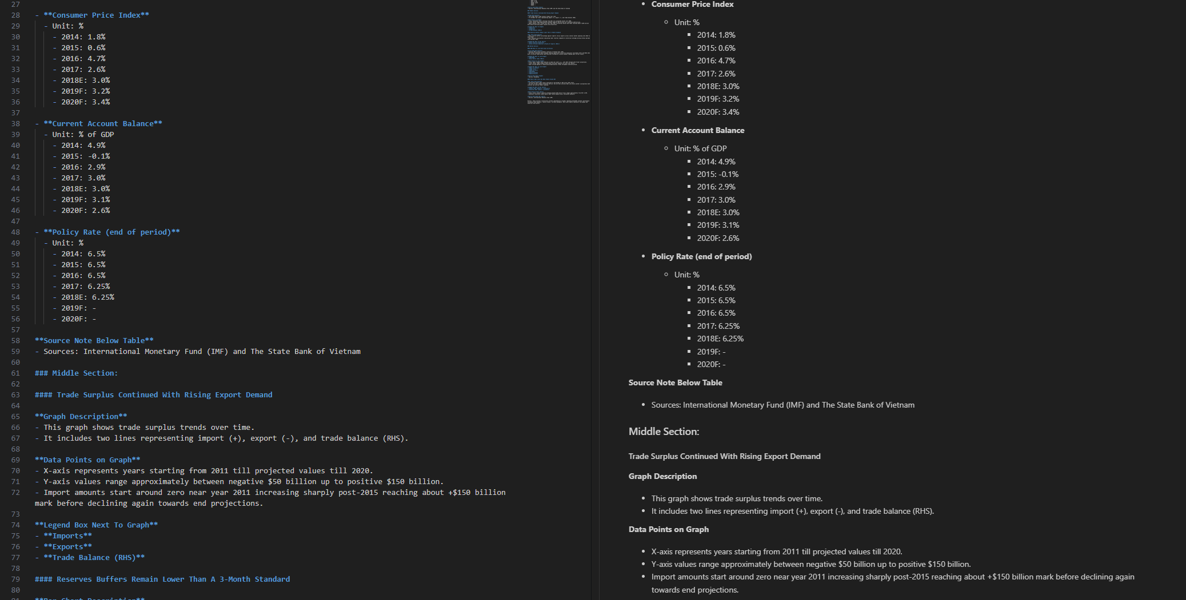
Main prompts
<image>\nDescribe this image in detail.
Rendering

Slide 9
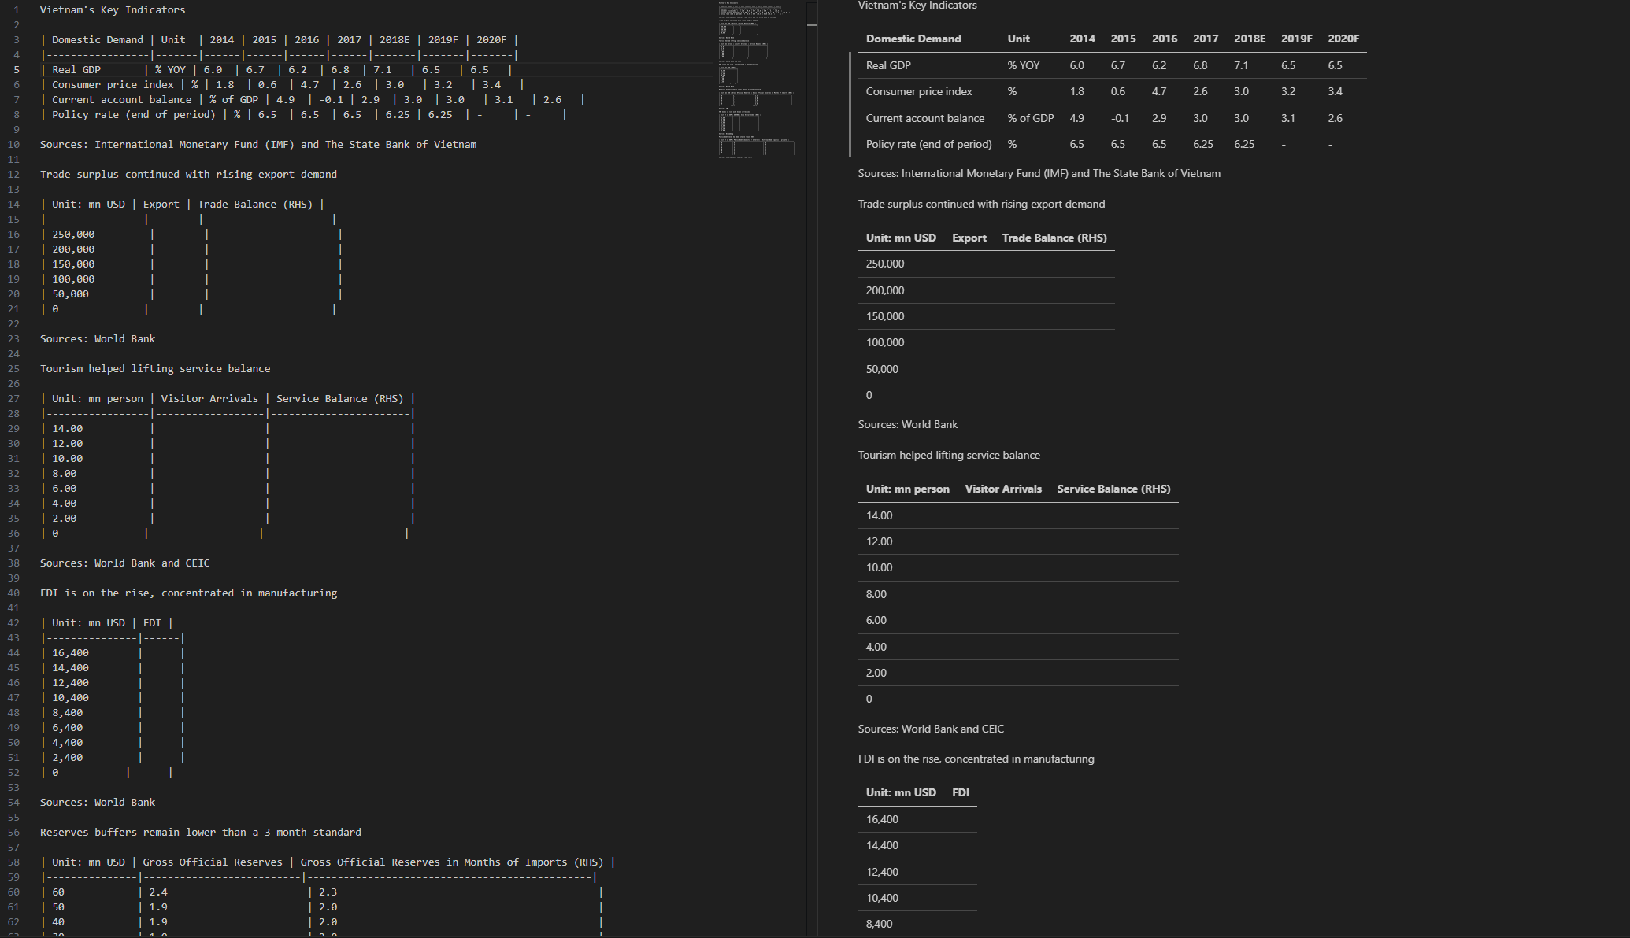
Main prompts
<image>\nParse the figure.
Rendering

Slide 10
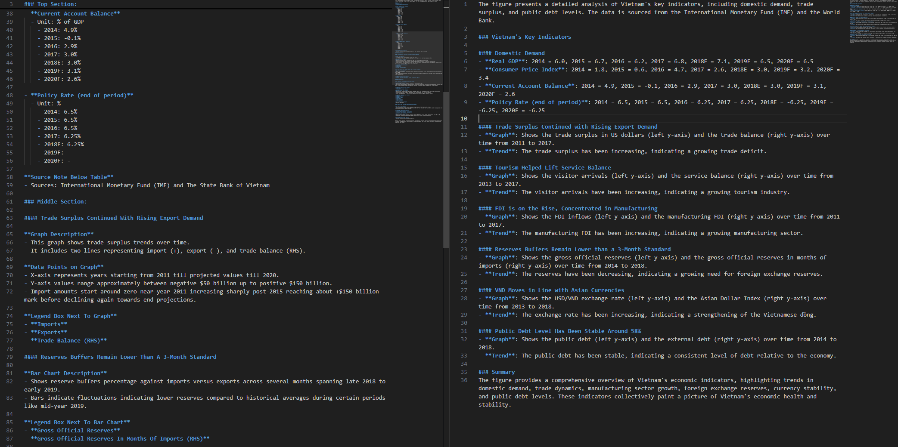
Main prompt vs Prompt engineering
<image>\nDescribe this image in detail. Parse all chart and table data and output them as HTML tables.
<image>\nDescribe this image in detail.
Top/Middle/Bottom section
Short introduction
Table to bullet points
Graph to description
Graph description
Data points on graph
x-axis, y-axis
Legend box next to graph
Source note below graph
Short summary
Top/Middle/Bottom section
Short introduction
Table to description
Graph to description
Graph description
left y-axis, right y-axis
Trend
Short summary

Slide 11
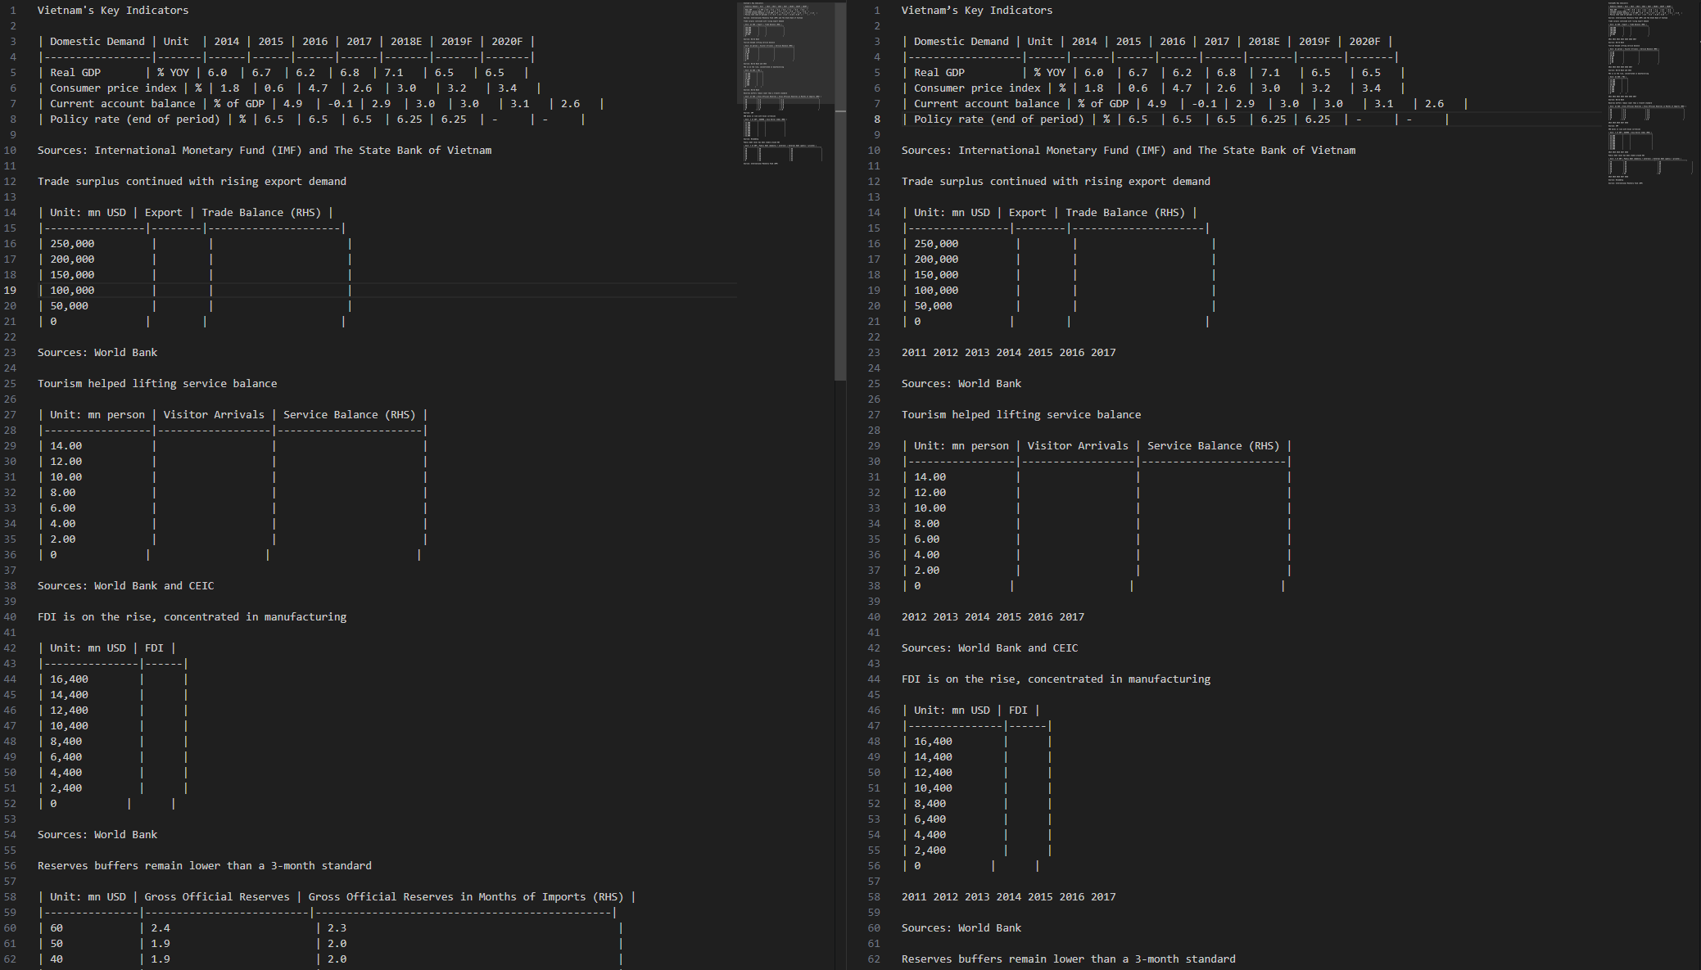
Main prompt vs Prompt engineering
<image>\nParse all charts and tables. Extract data as HTML tables.
<image>\nParse the figure.
Similar outputs
Give x-axis values placed below markdown table

Slide 12
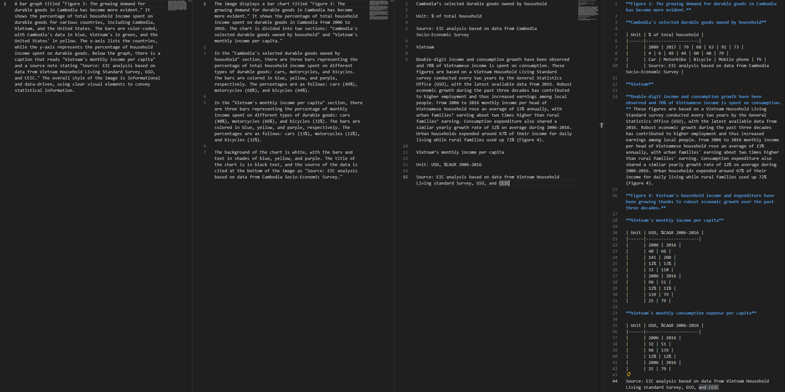
Multiple graphs with text
<image>\nDescribe this image in detail. Parse all chart and table data and output them as HTML tables.
<image>\nParse all charts and tables. Extract data as HTML tables.
<image>\nDescribe this image in detail.
<image>\nParse the figure.
Errors:
Description of each graph cannot be provided.
Markdown/HTML tables are missing from 2nd and 3rd prompt.

Slide 13
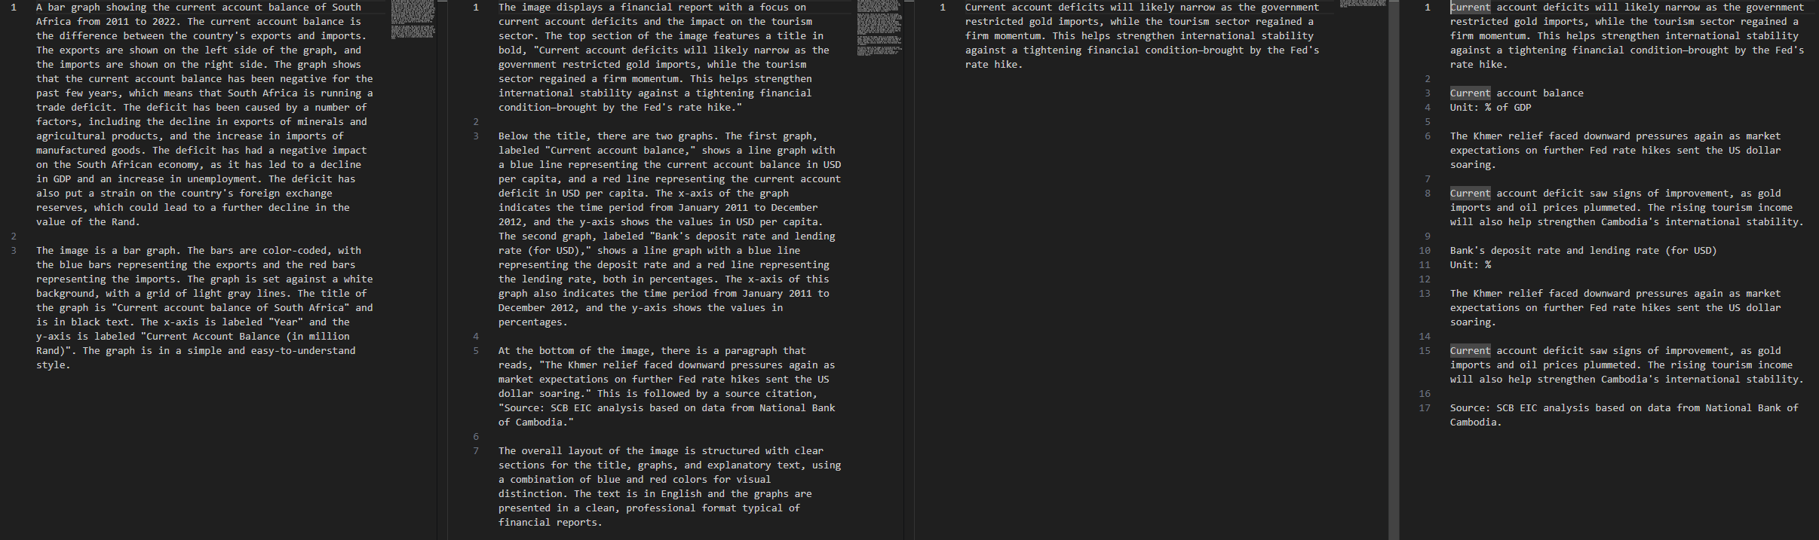
Presentation slide
<image>\nDescribe this image in detail. Parse all chart and table data and output them as HTML tables.
<image>\nParse all charts and tables. Extract data as HTML tables.
<image>\nDescribe this image in detail.
<image>\nParse the figure.
Errors:
The prompt cannot define left/middle/right sides in the presentation slide.

Slide 14
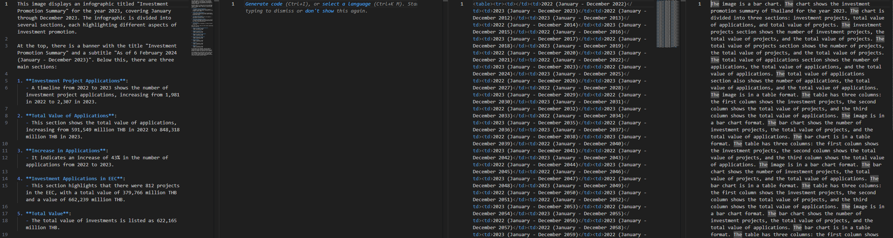
Infographics
<image>\nDescribe this image in detail. Parse all chart and table data and output them as HTML tables.
<image>\nParse all charts and tables. Extract data as HTML tables.
<image>\nDescribe this image in detail.
<image>\nParse the figure.
Remark:
The most appropriate prompt for infographic is “<image>\nDescribe this image in detail.”
It can separately capture every sections in the entire image.

Slide 15
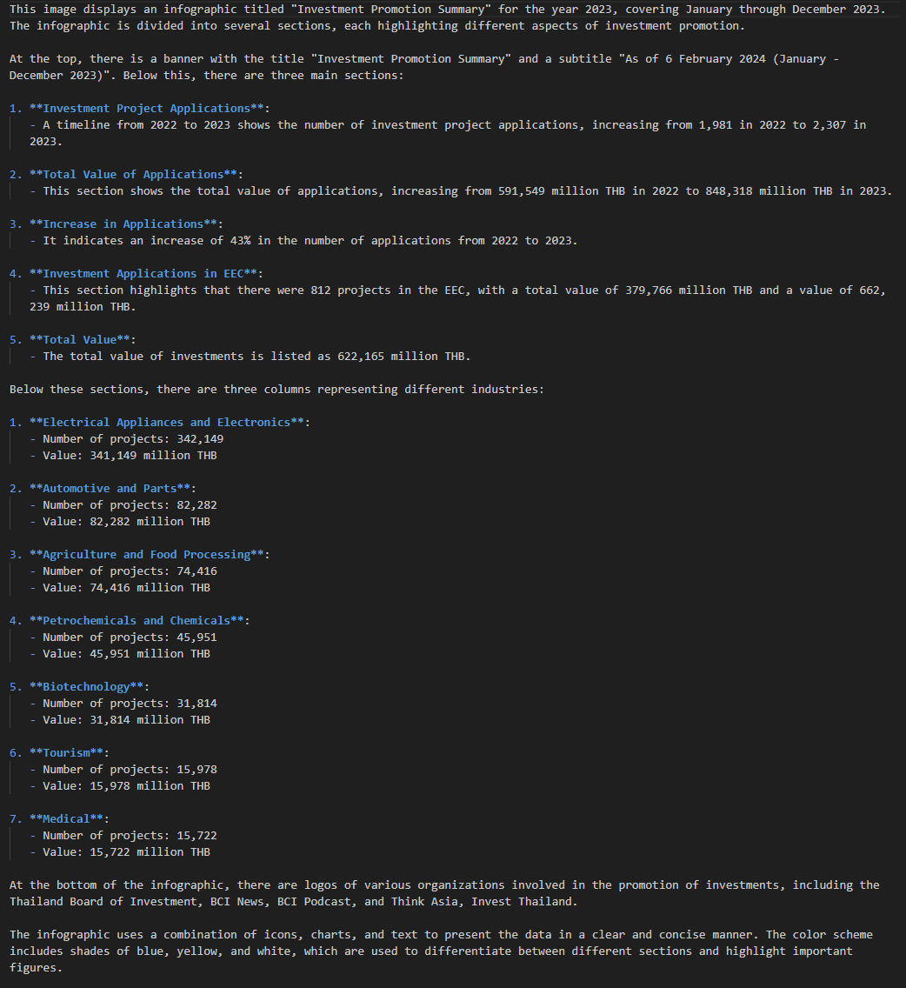
Infographics
<image>\nDescribe this image in detail.

Slide 16

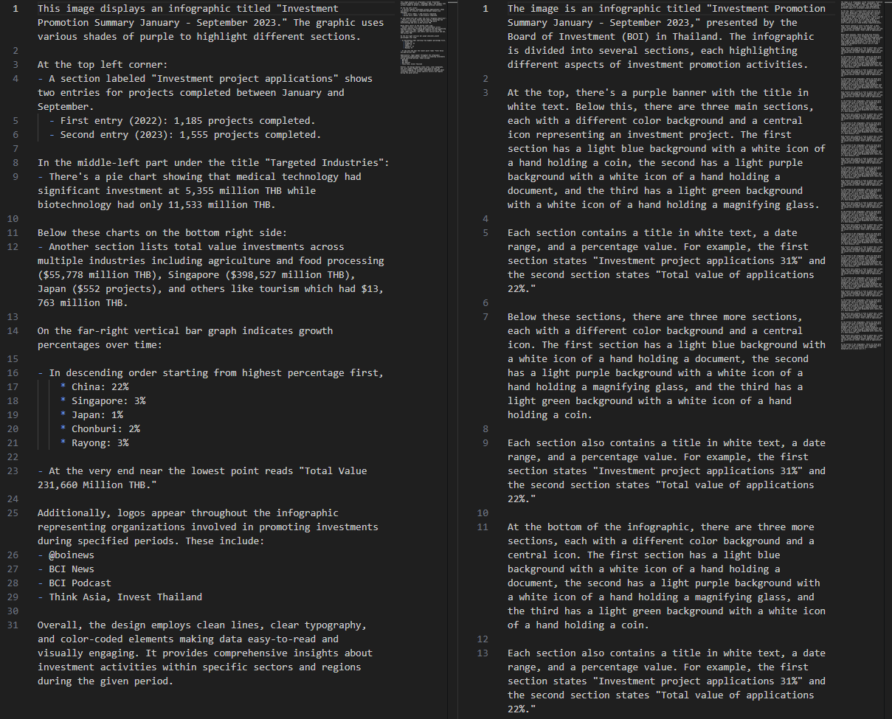
Infographics
<image>\nParse the figure.
<image>\nDescribe this image in detail.
Errors:
“<image>\nParse the figure” can also give image description rather than markdown/HTML table.

Slide 17
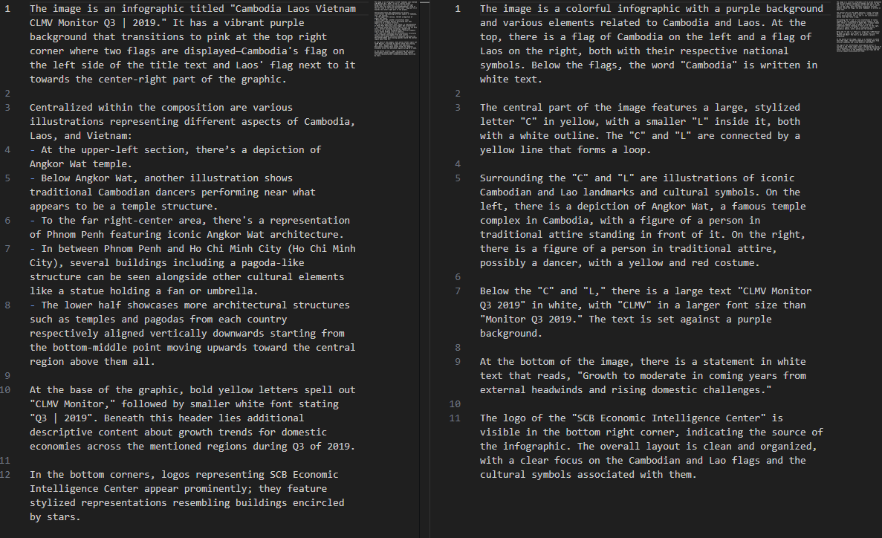
Image
<image>\nParse the figure.
<image>\nDescribe this image in detail.
Remark:
The model works quite well on a general image. → should keep this feature

Slide 18
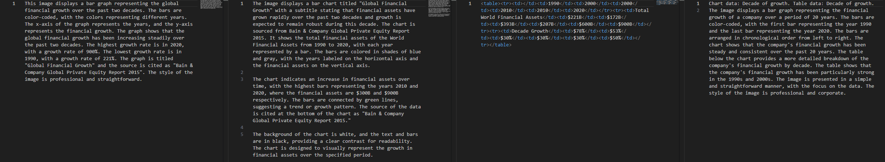
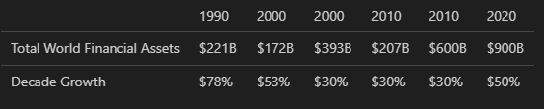
Vertical bar chart
<image>\nDescribe this image in detail. Parse all chart and table data and output them as HTML tables.
<image>\nParse all charts and tables. Extract data as HTML tables.
<image>\nDescribe this image in detail.
<image>\nParse the figure.
Rendering

Slide 19
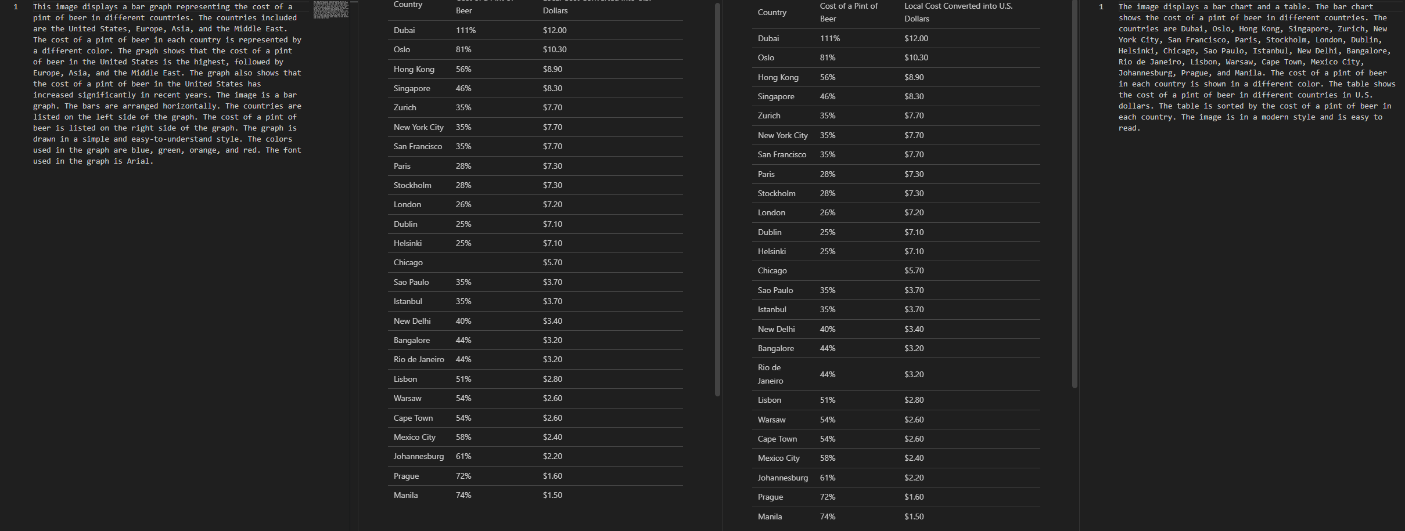
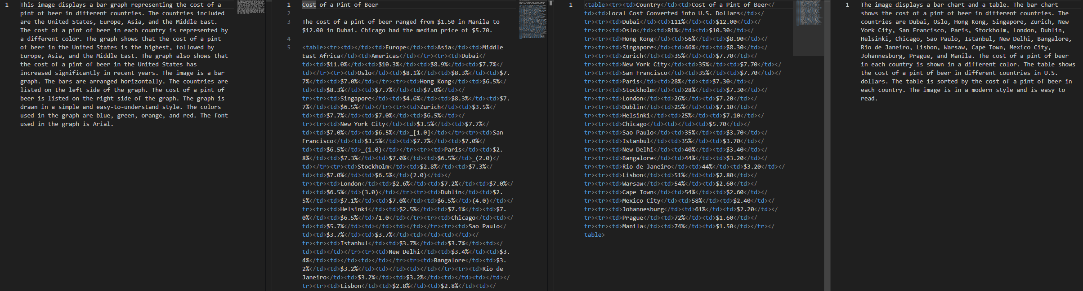
Horizontal bar chart
<image>\nDescribe this image in detail. Parse all chart and table data and output them as HTML tables.
<image>\nParse all charts and tables. Extract data as HTML tables.
<image>\nDescribe this image in detail.
<image>\nParse the figure.
Remark:
For simple chart, HTML table can be extracted more correctly.

Slide 20
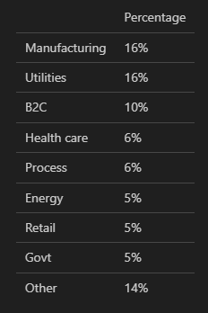
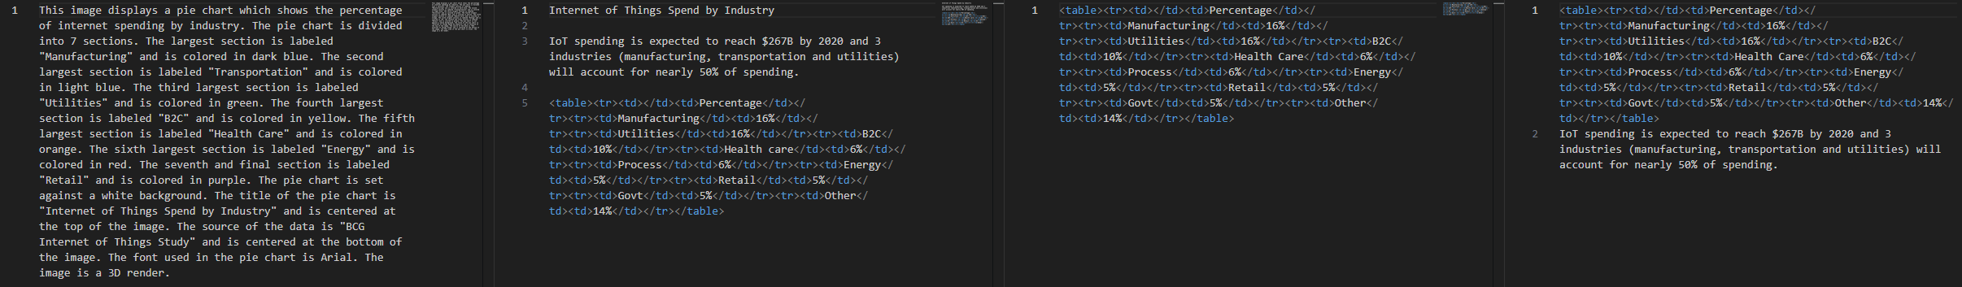
Pie chart
Rendering
<image>\nDescribe this image in detail. Parse all chart and table data and output them as HTML tables.
<image>\nParse all charts and tables. Extract data as HTML tables.
<image>\nDescribe this image in detail.
<image>\nParse the figure.
Remark:
For simple chart, HTML table can be extracted more correctly.
Description provides wrong colors for each section of the pie chart.

Slide 21
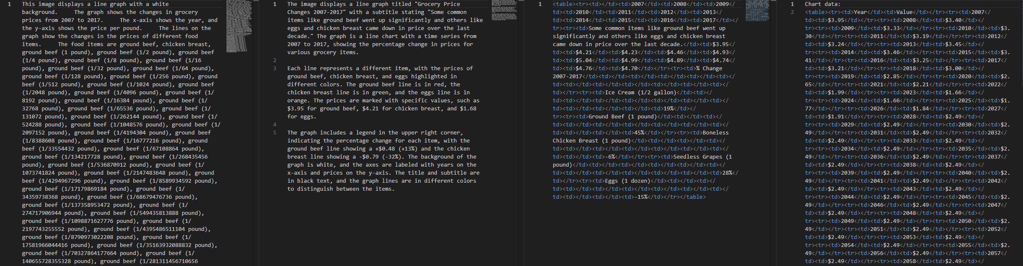
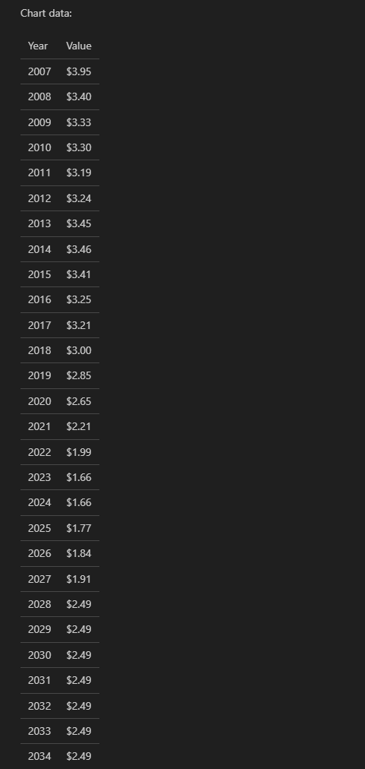
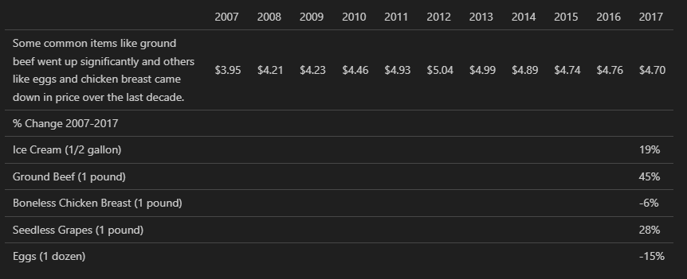
Line chart
<image>\nDescribe this image in detail. Parse all chart and table data and output them as HTML tables.
<image>\nParse all charts and tables. Extract data as HTML tables.
<image>\nDescribe this image in detail.
<image>\nParse the figure.
Remark:
For line chart with many values, “<image>\nParse the figure.” can give better explanation than “<image>\nDescribe this image in detail.”

Slide 22
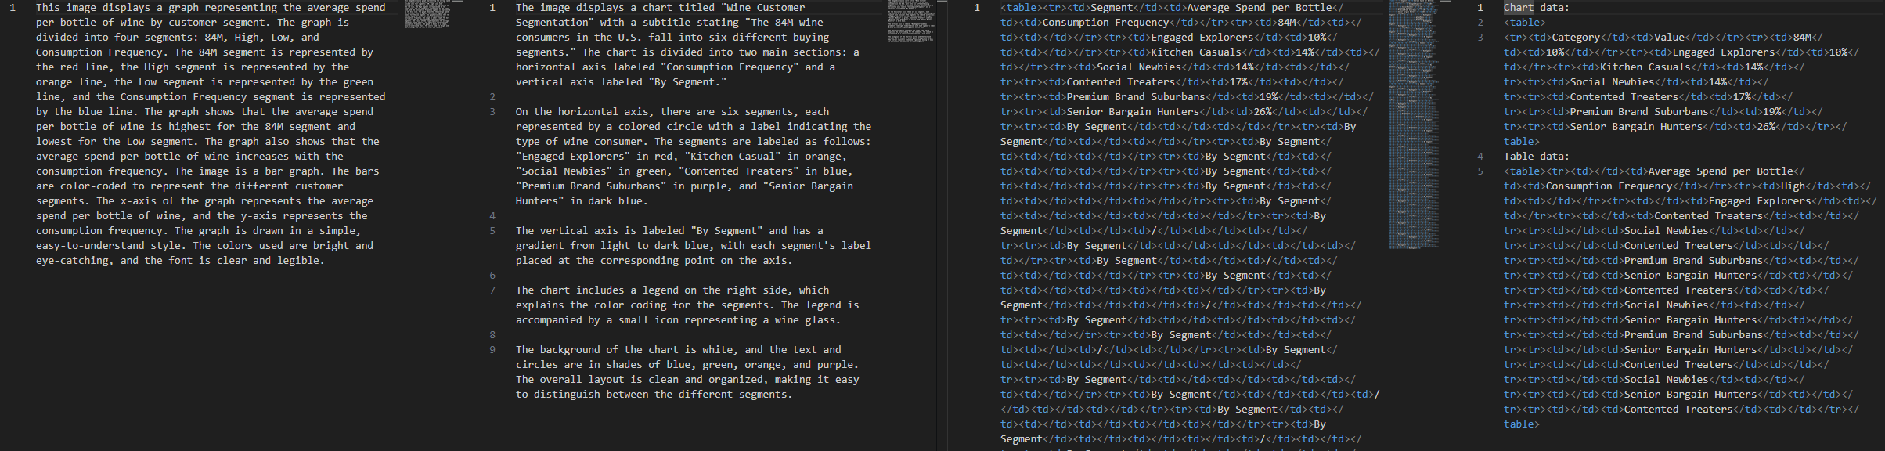
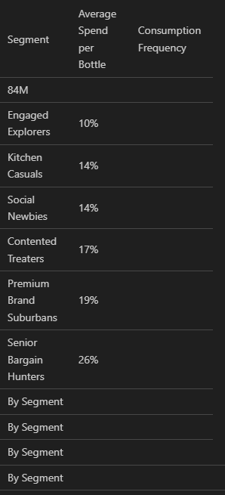
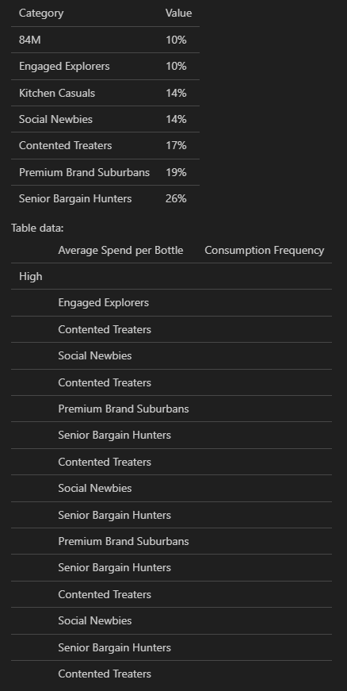
Bubble chart
<image>\nDescribe this image in detail. Parse all chart and table data and output them as HTML tables.
<image>\nParse all charts and tables. Extract data as HTML tables.
<image>\nDescribe this image in detail.
<image>\nParse the figure.
Remark:
For “<image>\nDescribe this image in detail.”, the model cannot define bubbles in the chart and uses “lines” instead.
While “<image>\nParse the figure.” describes as circles.

Slide 23
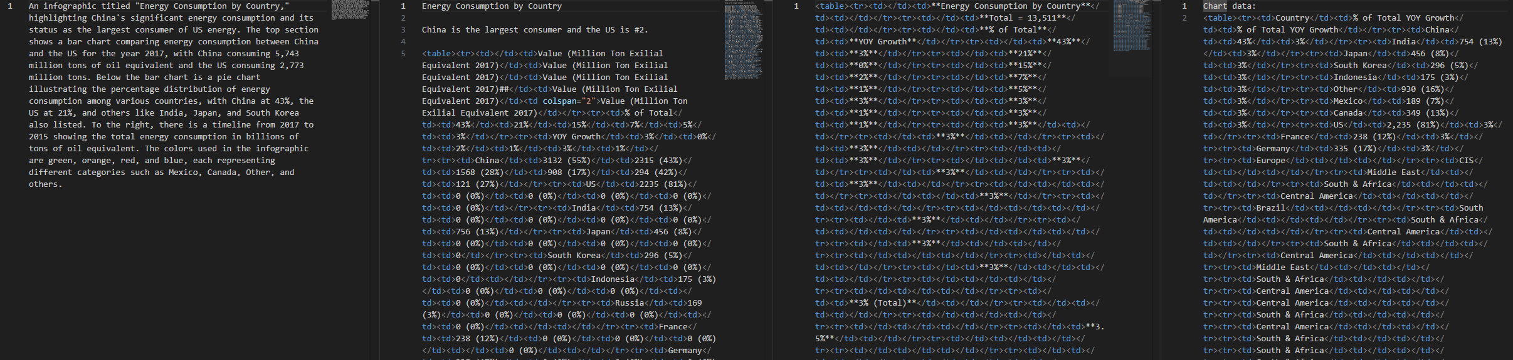
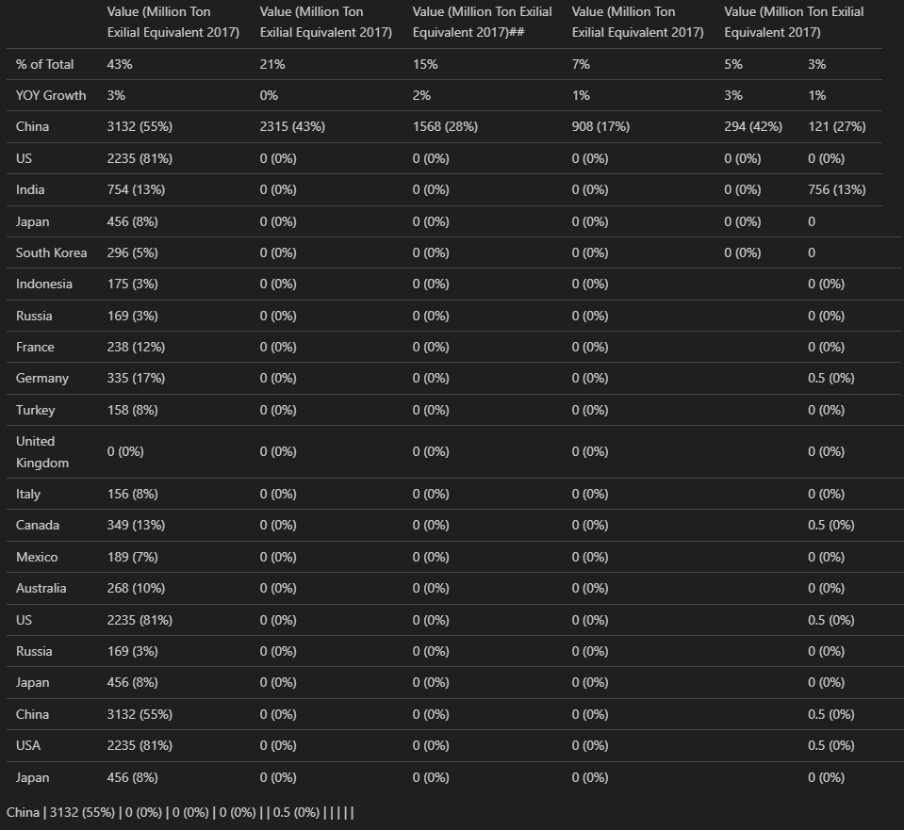
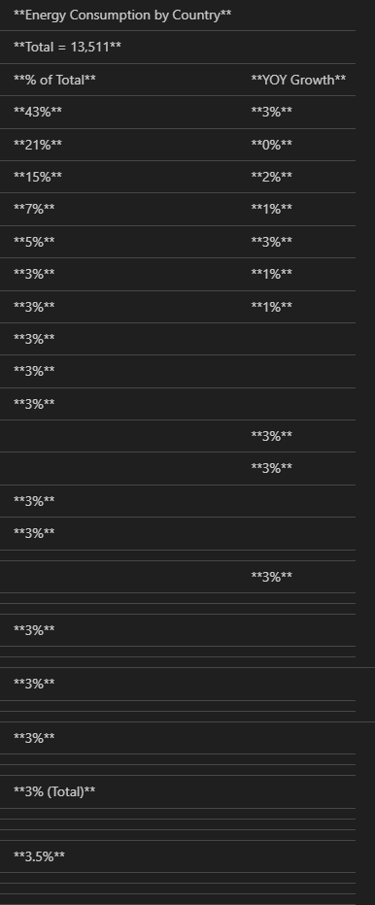
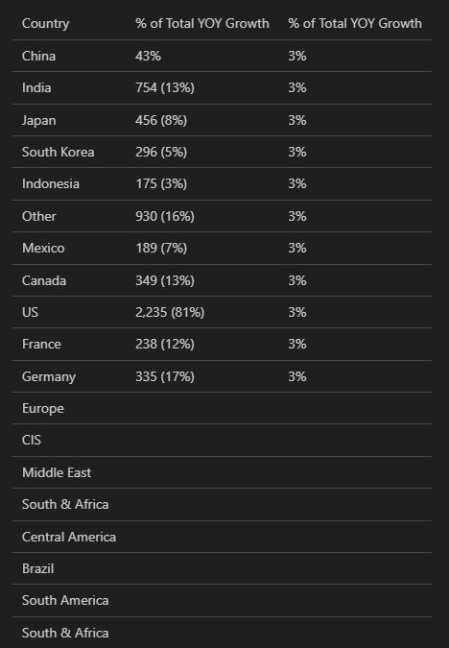
Marimekko chart
<image>\nDescribe this image in detail. Parse all chart and table data and output them as HTML tables.
<image>\nParse all charts and tables. Extract data as HTML tables.
<image>\nDescribe this image in detail.
<image>\nParse the figure.
Error:
For chart with a lot of details, description and HTML table are incorrect.

Slide 24
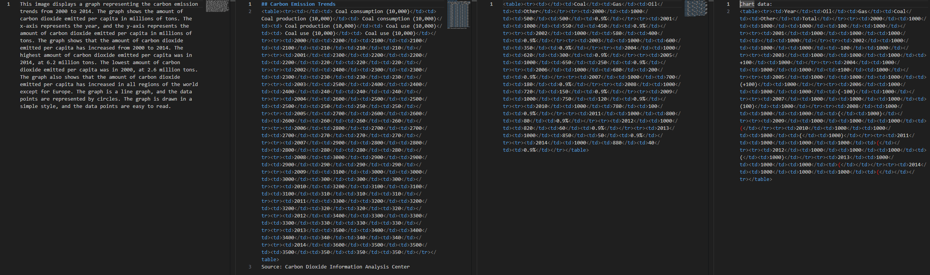
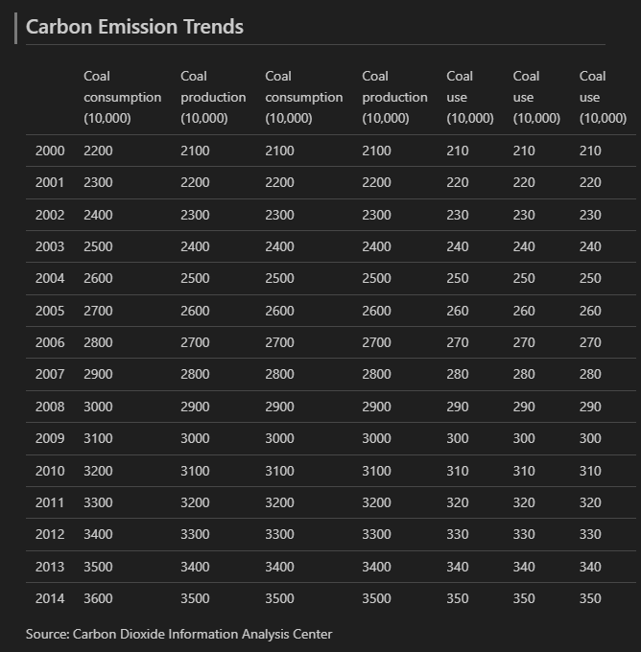
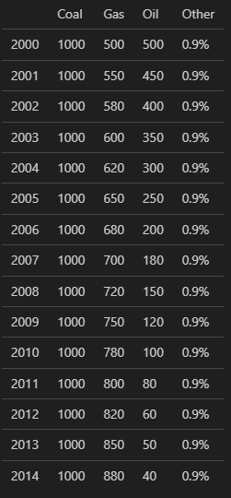
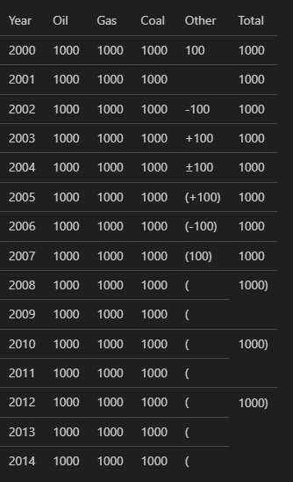
Area plot
<image>\nDescribe this image in detail. Parse all chart and table data and output them as HTML tables.
<image>\nParse all charts and tables. Extract data as HTML tables.
<image>\nDescribe this image in detail.
<image>\nParse the figure.
Error:
The model explains it as a line graph with circles (data points) and cannot determine different areas in the plot.

Slide 25


Scatter plot
<image>\nDescribe this image in detail. Parse all chart and table data and output them as HTML tables.
<image>\nParse all charts and tables. Extract data as HTML tables.
<image>\nDescribe this image in detail.
<image>\nParse the figure.
Remark:
The model can define number of scatter points in the graph and give corrected description.

Slide 26


Trend
<image>\nDescribe this image in detail. Parse all chart and table data and output them as HTML tables.
<image>\nParse all charts and tables. Extract data as HTML tables.
<image>\nDescribe this image in detail.
<image>\nParse the figure.

Slide 27

Thai plot
<image>\nDescribe this image in detail. Parse all chart and table data and output them as HTML tables.
<image>\nParse all charts and tables. Extract data as HTML tables.
<image>\nDescribe this image in detail.
<image>\nParse the figure.

Slide 28


Summary
Training strategy:
Graph description
<image>\nDescribe this image in detail.
Graph to markdown/HTML table
<image>\nParse the figure.
<image>\nParse all charts and tables. Extract data as HTML tables.
One graph vs Multiple graphs in an image
For one graph, the model gives more explanation and more corrected markdown/HTML table than multiple graphs in an image.
Method 1: Scan overall image → focus on each image in the picture
Method 2: Resolution modes (Tiny, Small, Base, Large, Gundam) → compression ratios/numbers of vision tokens

Slide 29
Data labeling for graph/chart
<image>\nDescribe this image in detail.
Introduction: This image displays…
### Top Section / Middle Section / Bottom Section:
**Title**
**Title name**
#### Graph title
**Graph Description**
This graph shows…
Type of graphs: line, bar, pie, bubble, area, scatter, trend
Type of relationships: linear, curvilinear, nonlinear, constant, positive, negative, cyclic, no relationship, hyperbola, parabola
Explanation: Trend starts from…increasing sharply to…before declining towards…
**Data Points on Graph**
X-axis represents…from…to…
Y-axis is…in the range of….
**Legend Box Next To Graph**
Legend 1
Legend 2
**Source Note Below Graph**
Sources: …
Summary
### Left Section / Middle Section / Right Section:
For presentation slides
**Remarkable point**

Slide 30
Data labeling for infographic
<image>\nDescribe this image in detail.
Modified template
Template from DeepSeek-OCR
Introduction: This image displays…
**Title**
**Title name**
### Top Section / Middle Section / Bottom Section:
#### Left side / Middle side / Right side:
1. **Topic 1**:
- Details…
2. **Topic 2**:
- Details…
3. **Topic 3**:
- Details…
Summary
Introduction: This image displays…
1. **Topic 1**:
- Details…
2. **Topic 2**:
- Details…
3. **Topic 3**:
- Details…
Summary

Slide 31
Data labeling for instruction fine-tuning
<image>\nParse the figure.
<image>\nParse all charts and tables. Extract data as HTML tables.
HTML table
Markdown table

Slide 32
Data labelling approaches
Manual labeling → Internal labeling → Outsourcing → Crowdsourcing = platforms that distribute labeling tasks to online human workers
Automated labeling → Programmatic labeling = using scripts to automatically label data → Synthetic labeling = generates new data from existing datasets using GANs (a generator and a discriminator)
Hybrid approaches → use an algorithm to pre-label data, → then human annotators (Human-in-the-loop strategy, HITL) review, validate, and correct the algorithm's output, focusing on complex or uncertain cases.
Use case data from Ann:
- include documents, presentation slides, infographics of 2000+ files (more from P’benz)
- source: web scraping for PMU (วิเคราะห์สินเชื่อ)

Slide 33
OCR:
- <image>\n<|grounding|>Convert the document to markdown.
- <image>\nFree OCR.
- [x]<image>\n<|grounding|>OCR the image.
- <image>\nConvert the document to markdown.
- <image>\nConvert the document to markdown. Extract tables as HTML tables.
- <image>\nConvert the document to markdown. Preserve all headings, lists, and reading order. All detected tables must be outputted as full HTML tables, not Markdown tables.
- <image>\n<|grounding|>Convert the document to markdown. Remove bounding boxes.
- <image>\n<|grounding|>Convert the document to markdown. Remove grounding.

Slide 34

Image description
Use case: Line chart, Scatter plot, Bar chart, Pie chart, Bubble chart, Area plot, Gantt chart, Trend, Dashboard, Marimekko chart, Infographic

